Slide 1
Capstone Project
Java Selenium Batch - 4
Name : Arka Deep Shit ID: 2433465

Slide 2
Agenda
Project Structure
Feature files
Runner Class
StepDefinitions
POM
Utility class
Base class
Extent Reports
Project config
Report class
GIT
Screenshots

Slide 3
Project Overview
This project delivers a comprehensive and scalable test automation framework designed specifically for the OrangeHRM application. Built on a powerful foundation of Selenium WebDriver and Java, the framework is meticulously managed using Maven for streamlined dependency handling and consistent build processes. It employs TestNG as its core test runner, providing robust control over the test execution lifecycle, including parallel testing capabilities and detailed assertions.
Adhering to Behavior-Driven Development (BDD) principles, the framework integrates Cucumber to translate business requirements into clear, human-readable Gherkin scenarios. This fosters seamless collaboration between technical and non-technical stakeholders.
The framework is equipped with essential features for modern testing needs, including built-in cross-browser support to ensure functionality across platforms like Chrome and Firefox. It facilitates data-driven testing, allowing scenarios to be executed against multiple data sets for thorough coverage. Reusable utilities and a Page Object Model (POM) design ensure the code is clean, maintainable, and scalable. Finally, it generates professional, detailed reports using tools like ExtentReports, complete with logs and screenshots, to provide clear and actionable feedback on the application's quality.

Slide 4
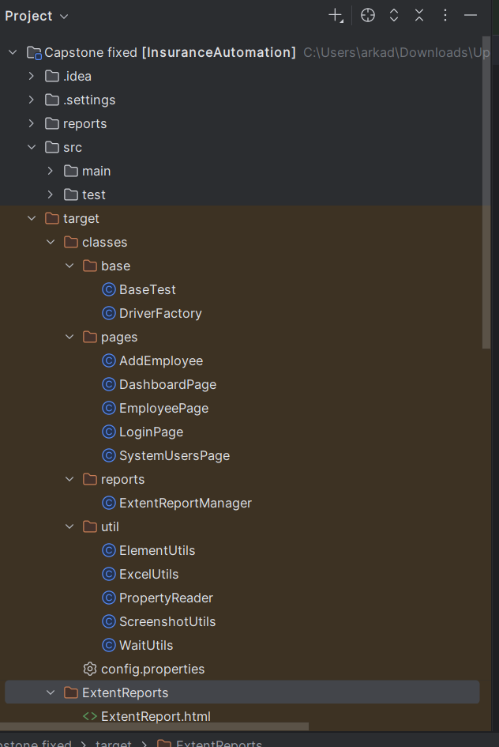
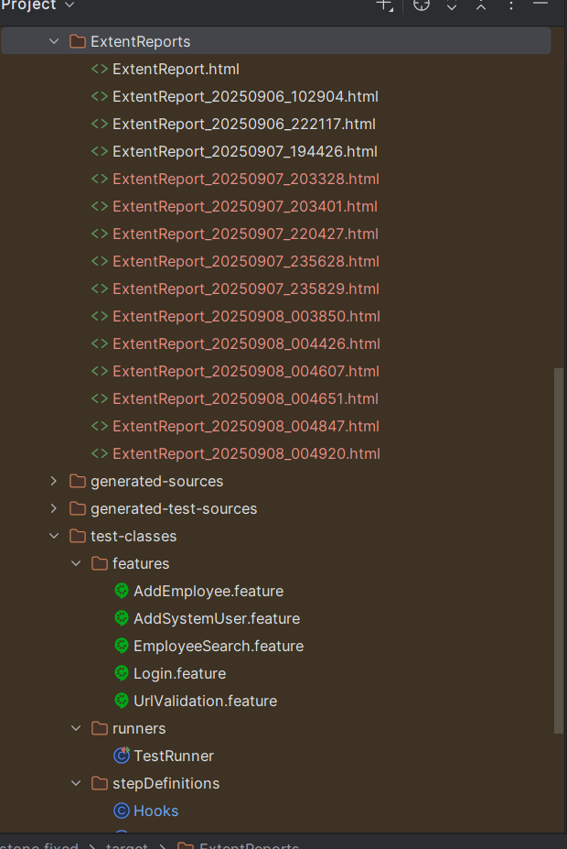
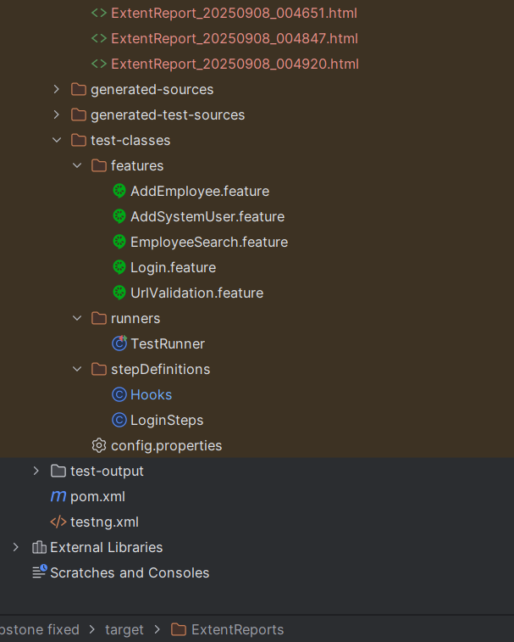
Project Structure -

Slide 5
Feature Files
. URL Validation
Correct URL → Redirect to login page //
Wrong URL → Page not found error //
. Login Functionality
Positive: Correct credentials → Dashboard displayed //
Negative: Invalid credentials → Login error //

Slide 6
. Add the Employee
Positive Testcase: Launch app → Login → Add employee → Verification success
Negative Testcase: Missing required fields → Verification error
. Search Employee
Positive: Search by ID → Verified record found
Negative: Search invalid ID → No verified record found
. Add System User
Positive: Add new user with all details → Verification success
Negative: Missing required fields → Verification validation error

Slide 7
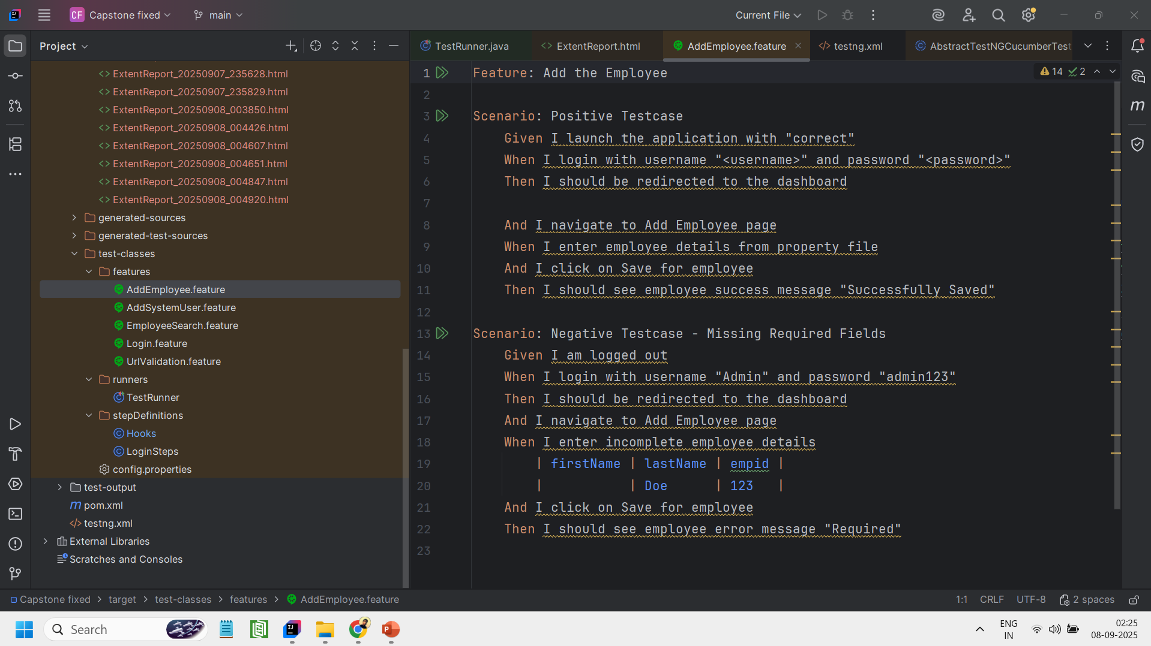
Feature Files - Screenshots
. Add the Employee

Slide 8
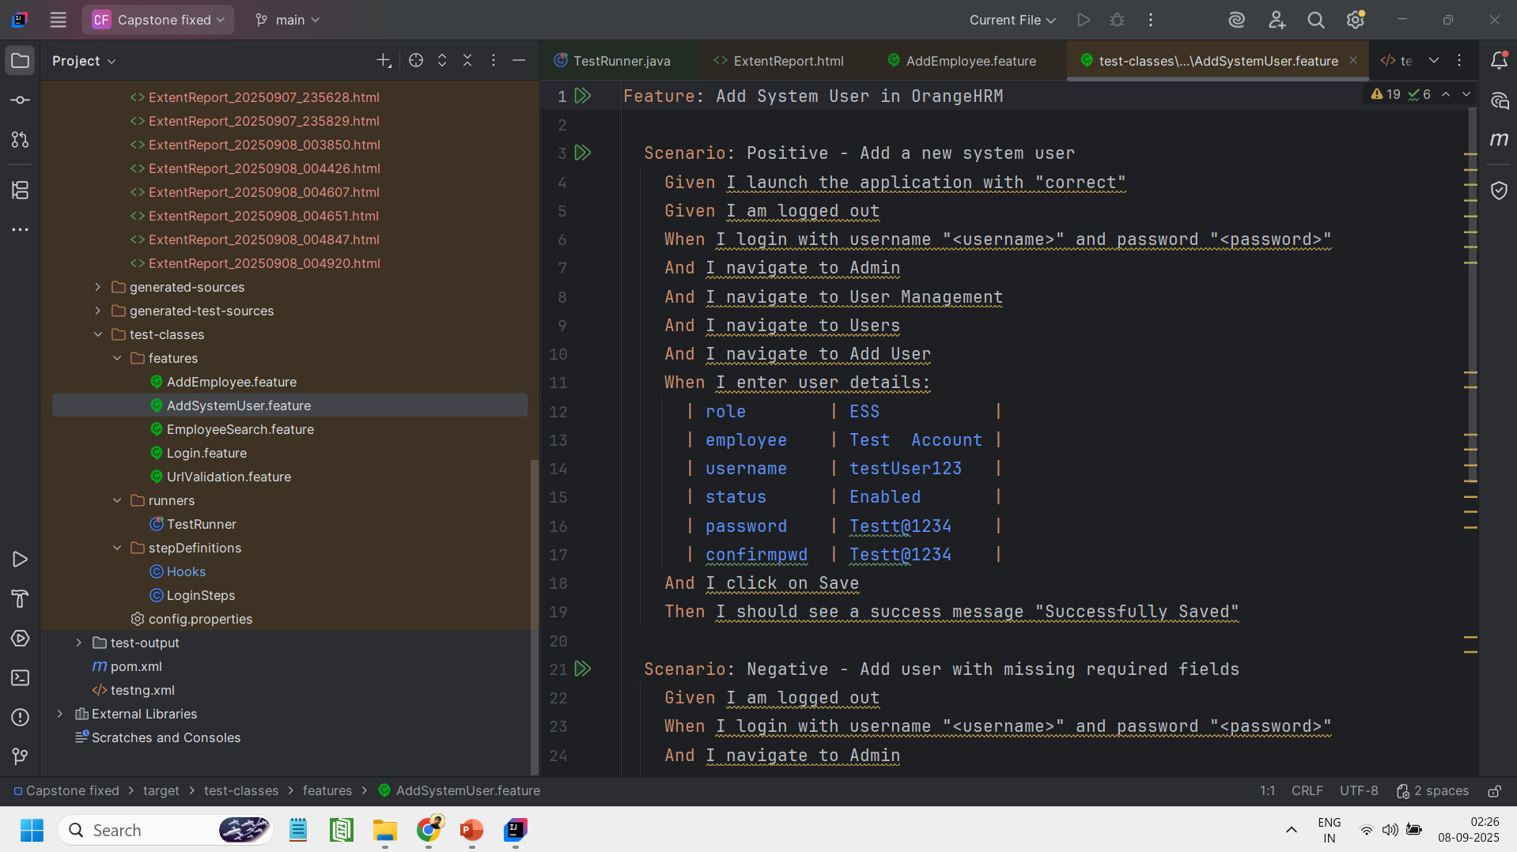
. Add System User

Slide 9
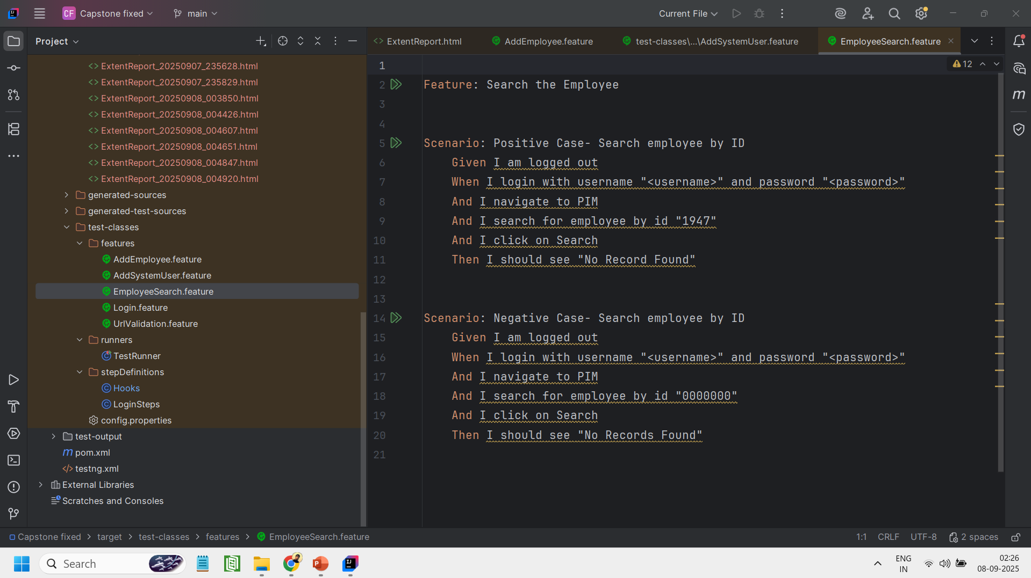
. Search Employee

Slide 10
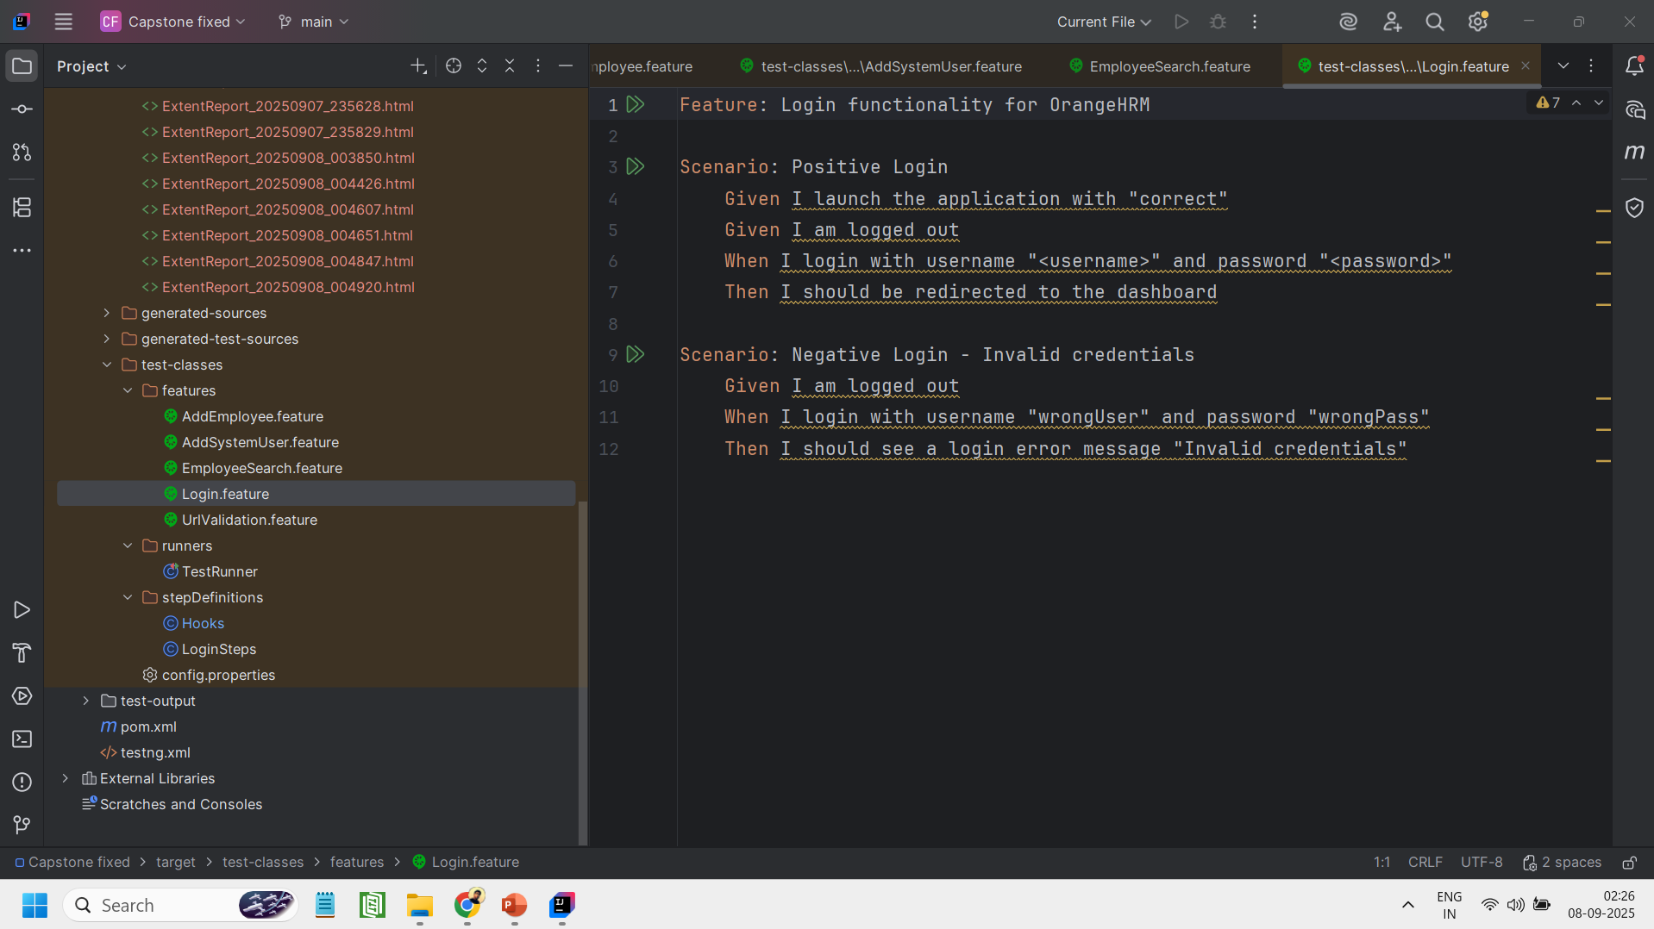
. Login Functionality

Slide 11
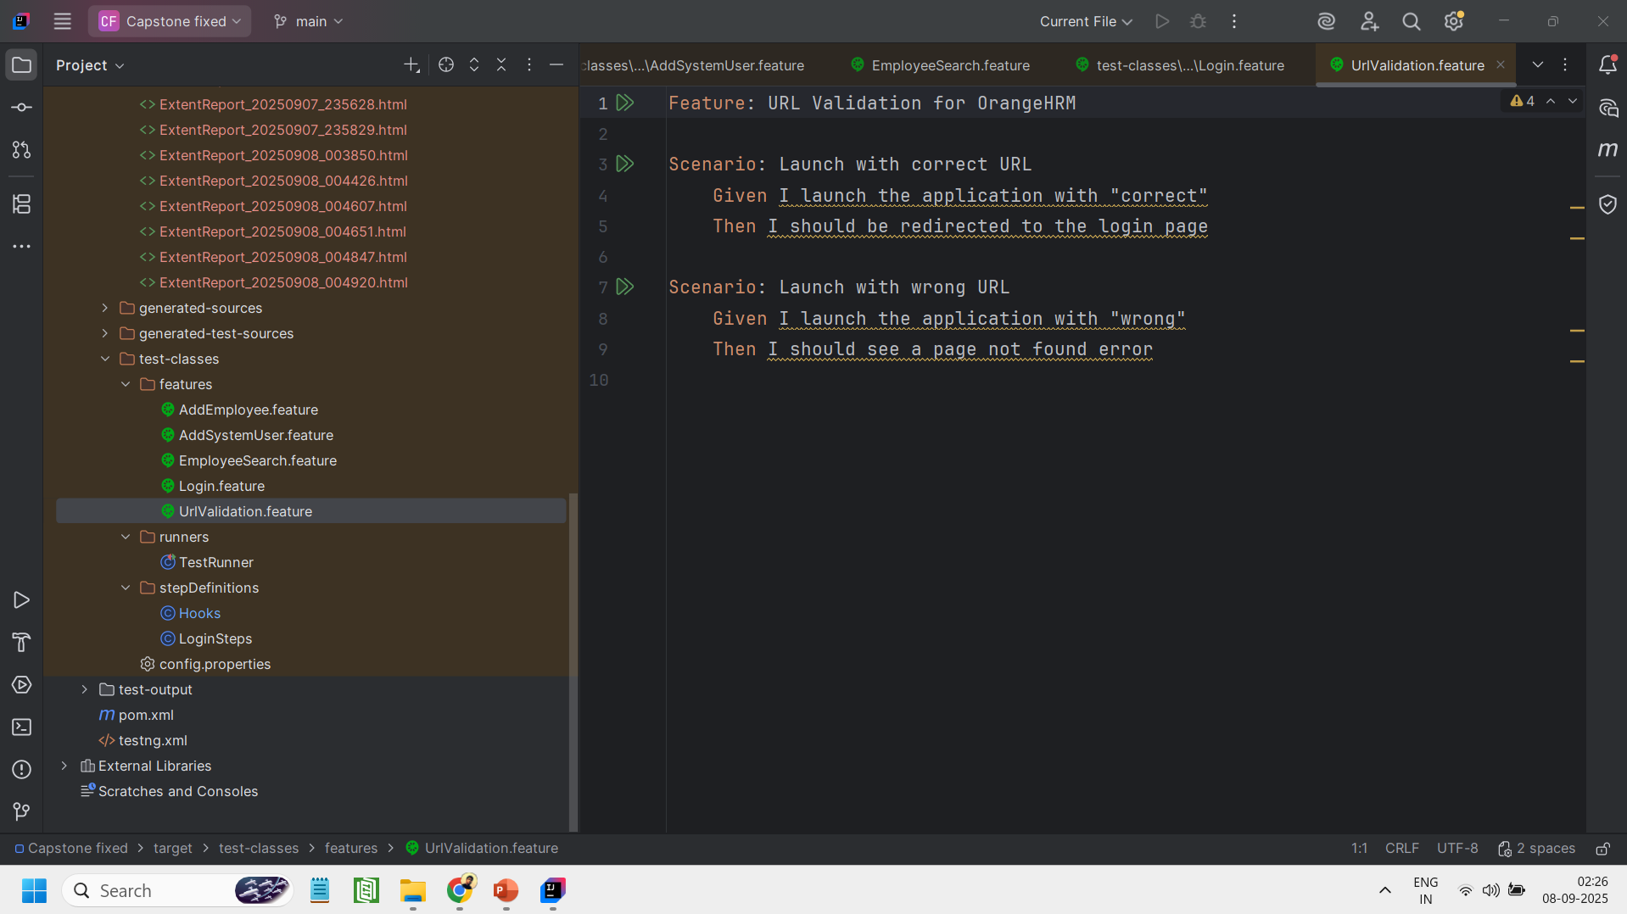
. URL Validation

Slide 12
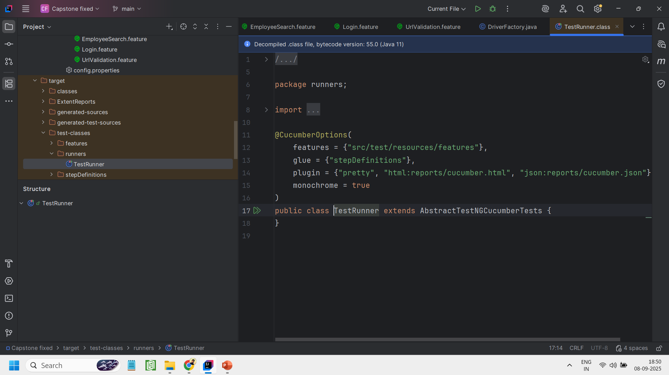
Runner class
The Test Runner class functions as the execution entry point for the test suite. Its primary responsibilities are to locate and run all specified feature files, to establish the integration between the Cucumber and TestNG frameworks, and to initiate the process of generating detailed automation reports upon test completion.
TestRunner.java -
The TestRunner.java class acts as the bridge between Cucumber and TestNG, enabling the execution of every feature file contained within the project.
This class is configured to define the paths for both the feature files and the step definition files, and it is set up to generate test results in both HTML and JSON formats.

Slide 13
Step Definitions
Hooks.java
The Hooks class handles the entire test lifecycle for all scenarios. It automates the pre-test setup by initializing the WebDriver and launching the application, and it performs post-test cleanup by closing the browser. This class also integrates with ExtentReports to produce professional reports, automatically logging the pass/fail status and attaching screenshots to each scenario's results.
LoginSteps.java
Implements Step Definitions: Contains the test logic for Login, Add Employee, Add User, and Search features.Drives
UI: Interacts with all necessary Page Objects.Logs
Results: Uses ExtentReports for step logging and screenshots.Validates
Outcomes: Employs TestNG to assert both positive and negative test results.Handles
Data: Manages dynamic data from property files and Cucumber DataTables.
Ensures Clean State: Logs out before scenarios to guarantee test independence.

Slide 14
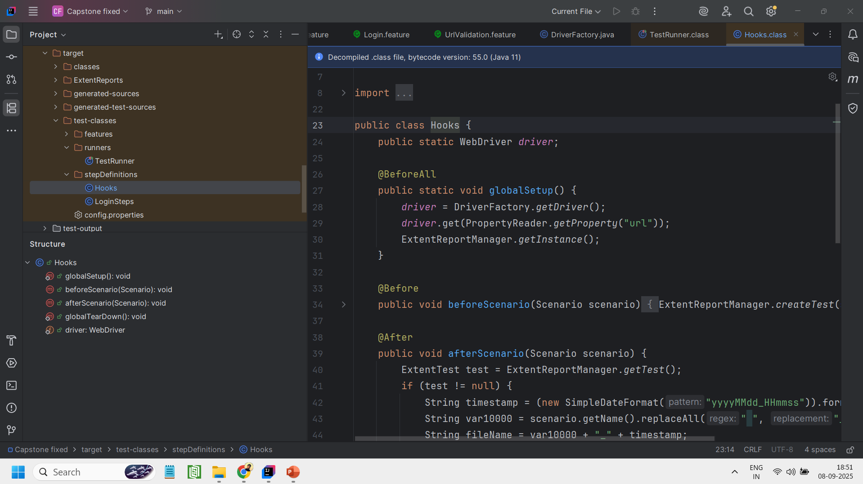
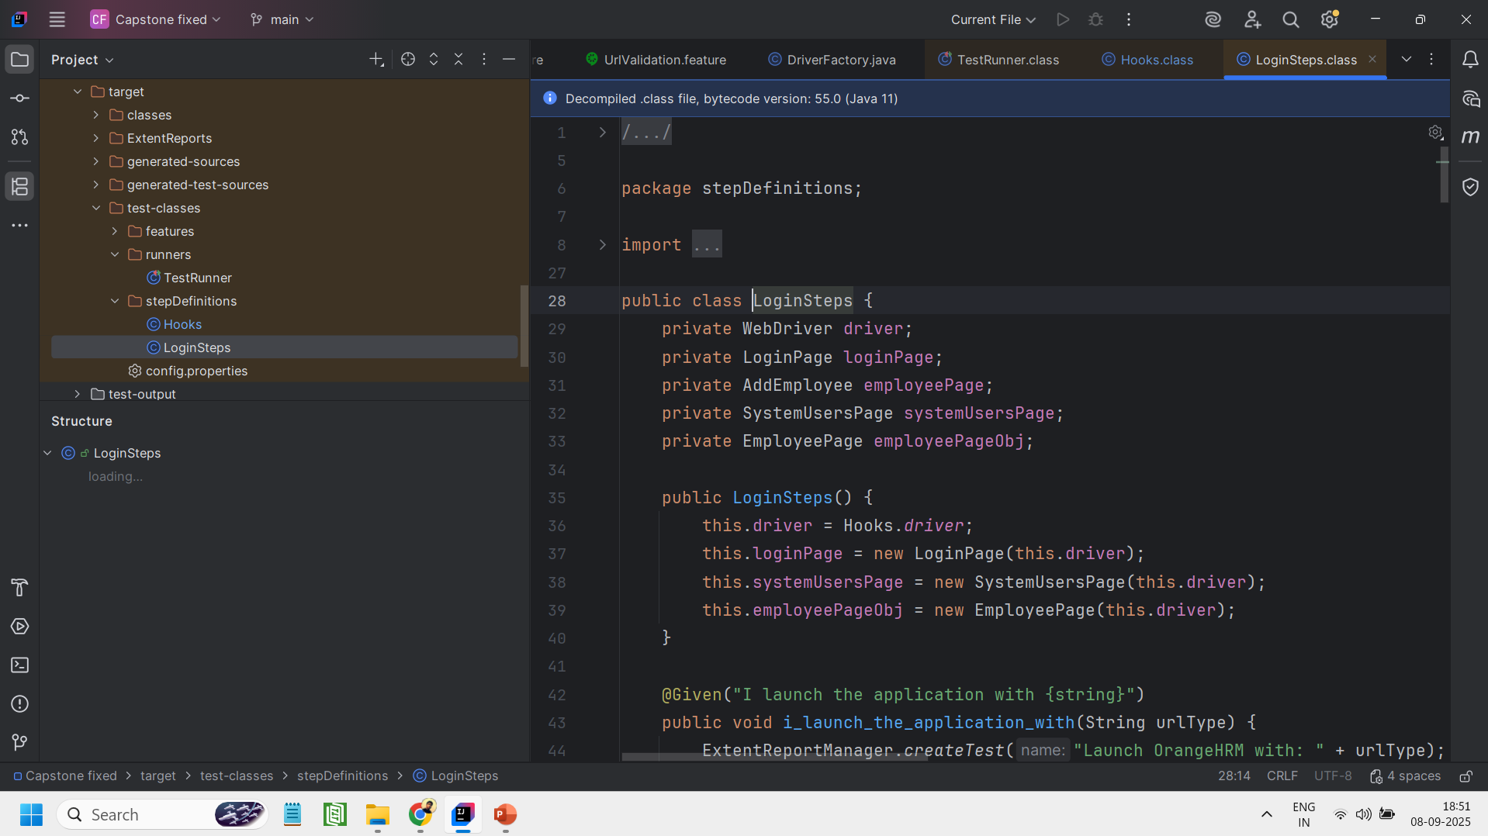
Hooks.java
LoginSteps.java

Slide 15
Page Object Model (POM) class
Login.java
This class is a Page Object that represents the Login page of the OrangeHRM application. It encapsulates the locators for the username, password, and login button elements. The class provides a reusable login() method to streamline the process of entering credentials and submitting the form. It also contains methods to verify the outcome of a login attempt, either by confirming a successful login or by capturing any error messages that are displayed.
DashboardPage.java
This DashboardPage class is a Page Object representing the main screen that appears after a successful login. It encapsulates the locators for key elements like the user menu and the logout button. The class provides essential methods to verify the user's logged-in status by checking for the visibility of the user menu. It also includes the functionality to perform a complete logout action, ensuring the application has successfully returned to the login page.

Slide 16
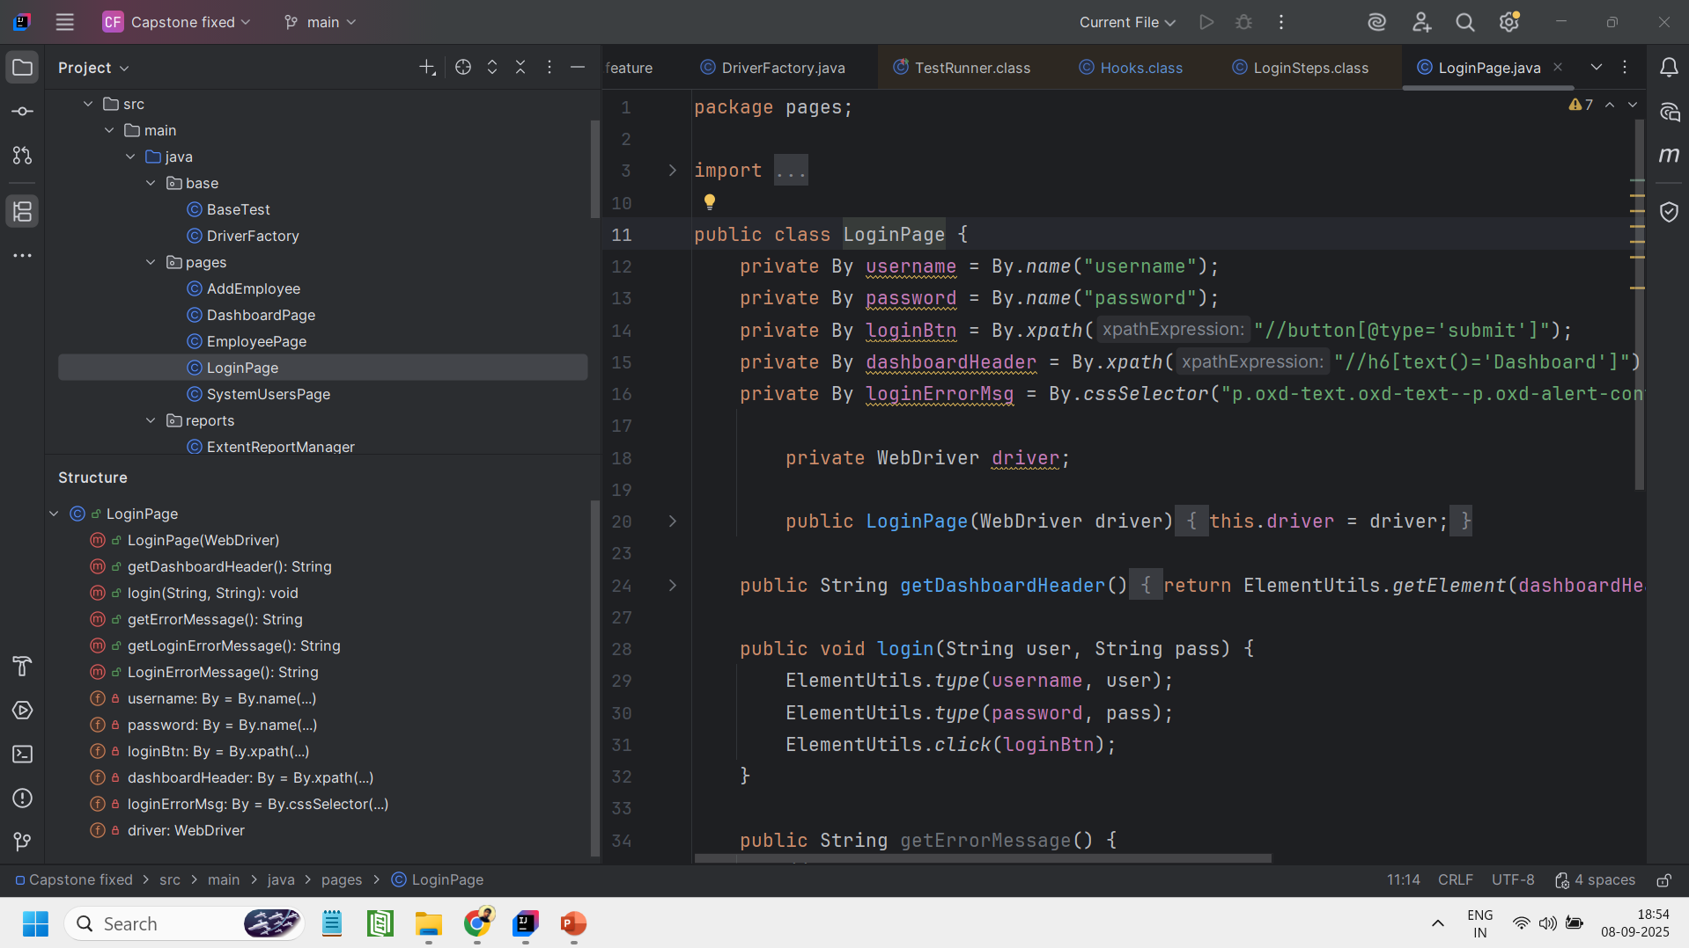
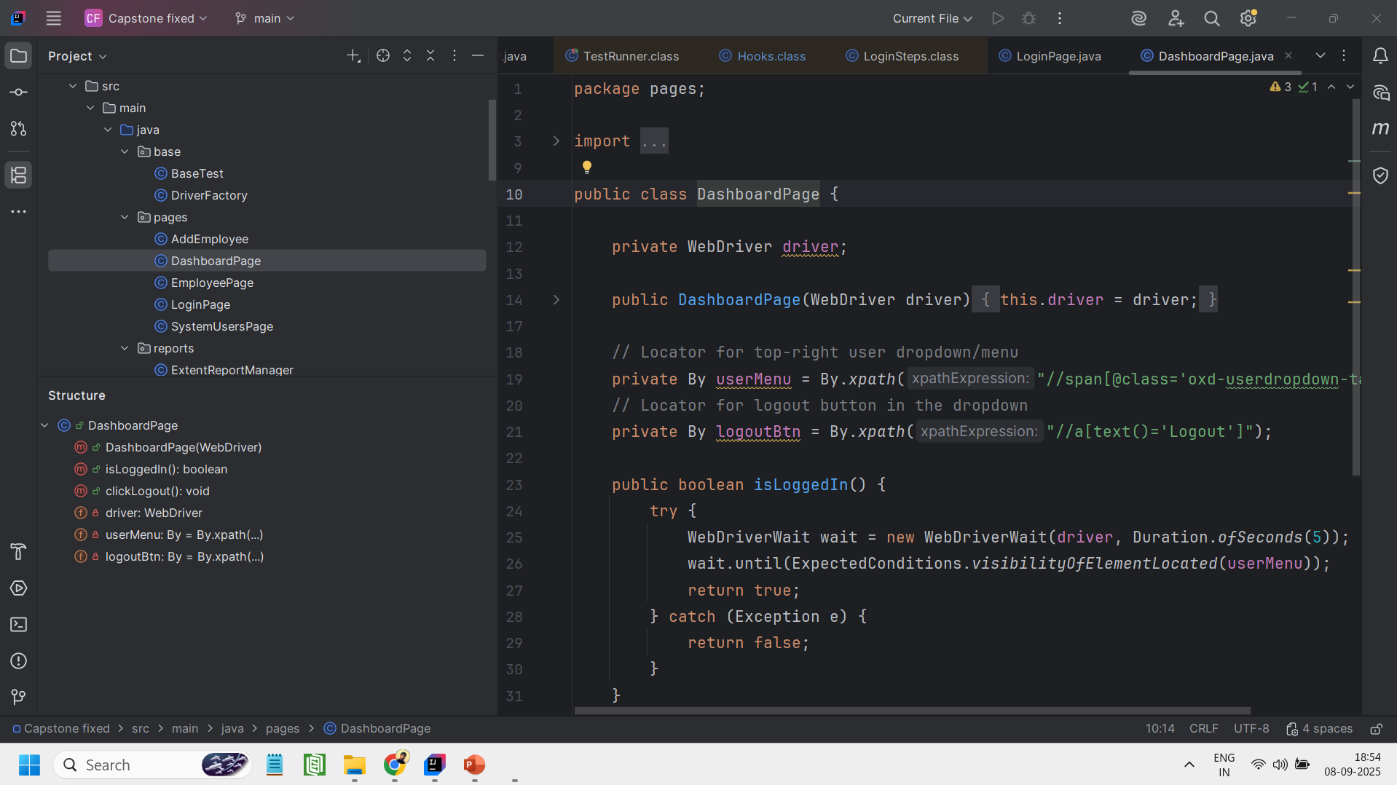
Login.java
DashboardPage.java

Slide 17
AddEmployee.java
This Page Object class represents the Add Employee page found within the PIM (Personal Information Management) module. It encapsulates all the necessary functionality for this page, providing reusable methods to automate the process of filling out employee details—such as first name, middle name, last name, and employee ID—and saving them to the system. The class also includes a verification method that confirms a new employee has been added successfully by checking for the appearance of a success message.
EmployeePage.java
This Page Object class represents the Employee Search page, which is located within the PIM (Personal Information Management) module. It provides dedicated methods to automate searching for employees using criteria such as their name or ID. Furthermore, the class includes essential verification logic to confirm the outcome of a search, allowing tests to check whether records were successfully found or if a "no records found" message was correctly displayed.
SystemUsersPage.java
This Page Object class represents the System Users page, where administrative users can be added and managed. It encapsulates the complete user creation workflow, starting with methods to navigate through the required menu structure: Admin > User Management > Users > Add User. The class provides functionality to automate filling out the "Add User" form with all necessary details, including user role, employee name, username, status, and password. Finally, it includes verification methods to check the outcome of the save operation by capturing and asserting the success or error messages displayed on the page.

Slide 18
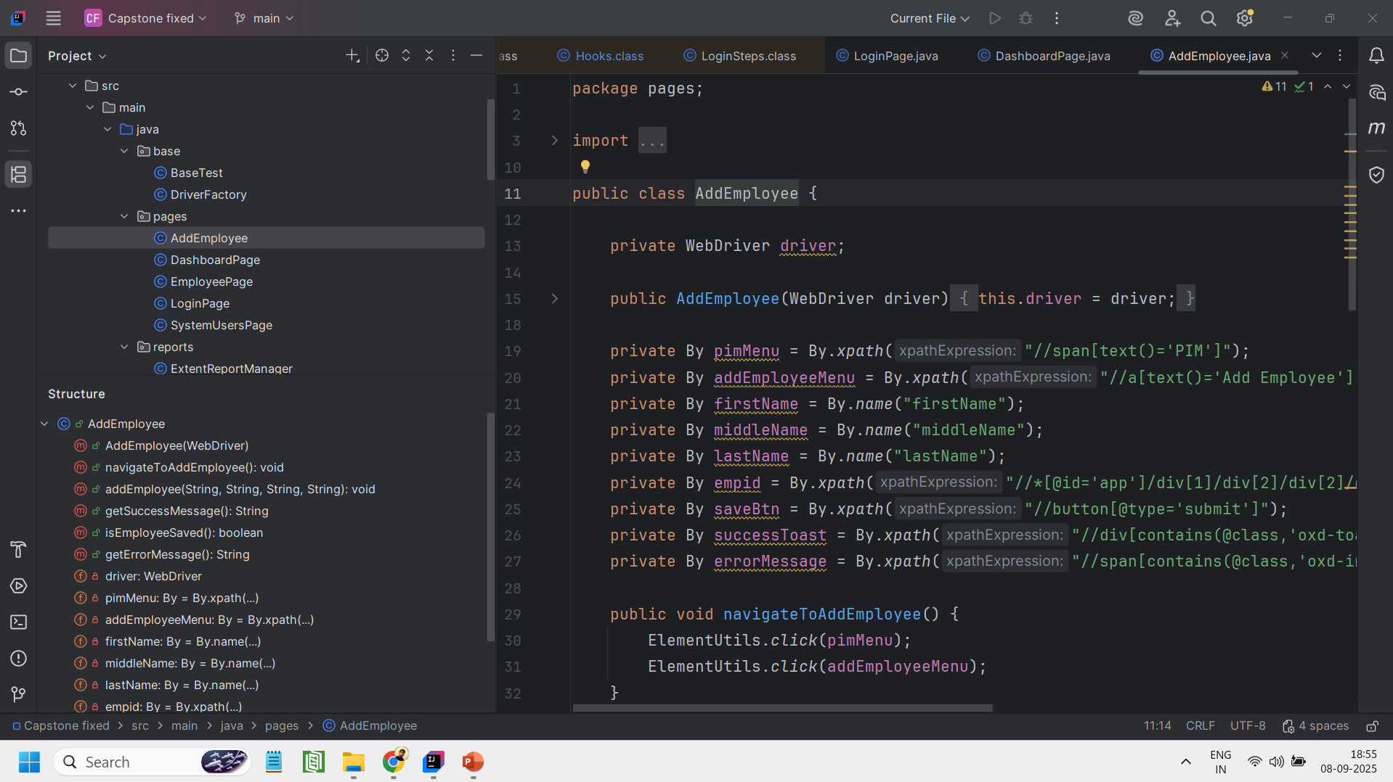
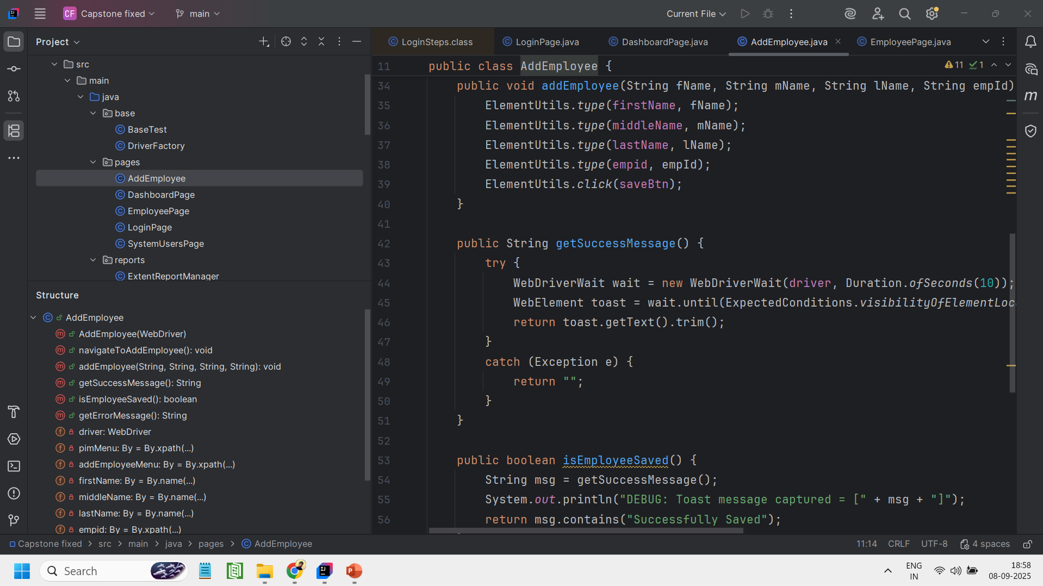
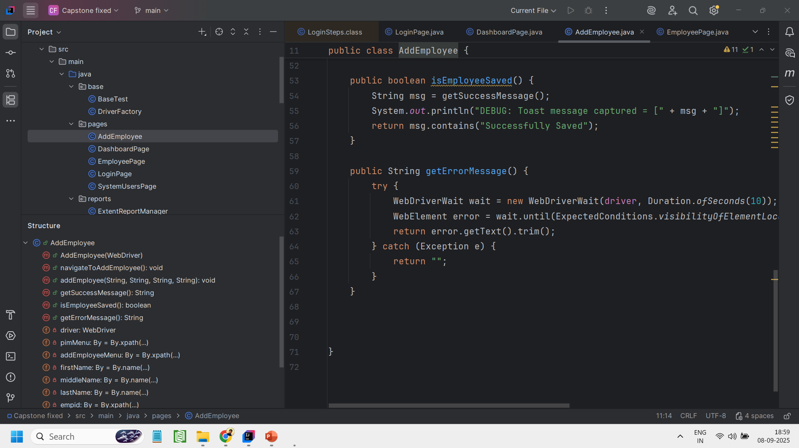
AddEmployee.java

Slide 19
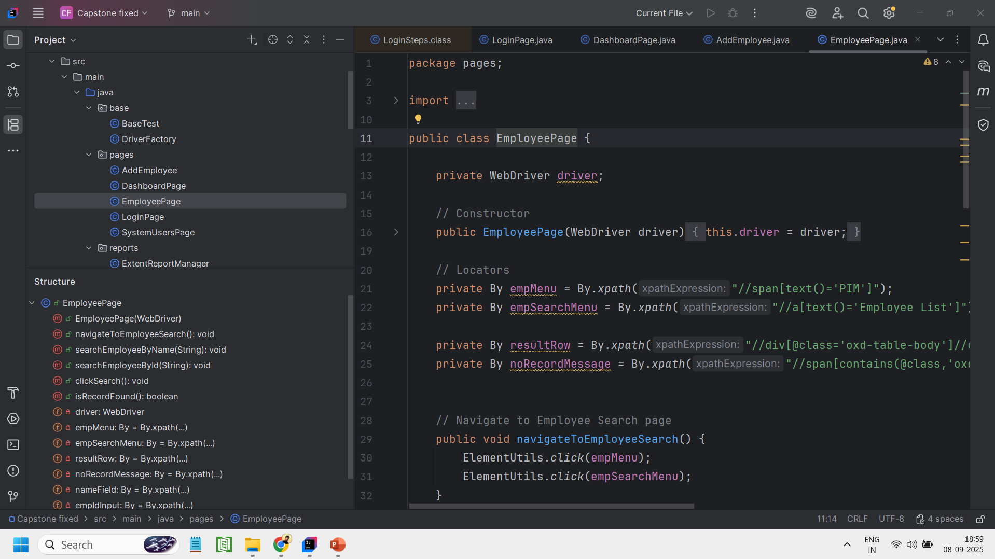
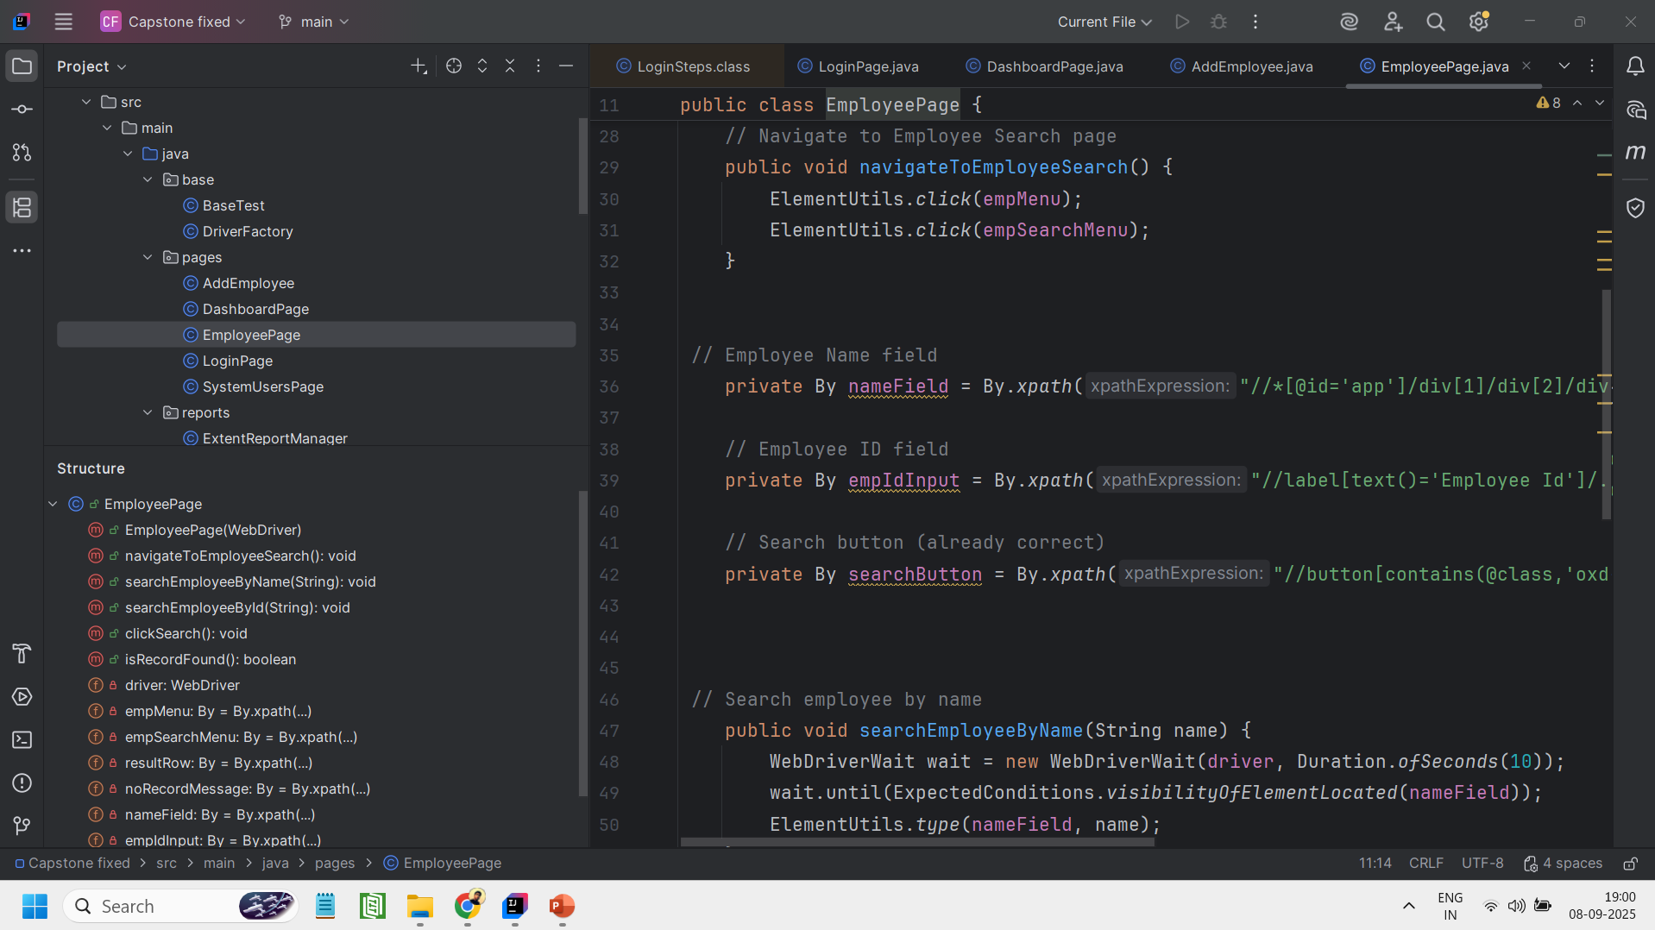
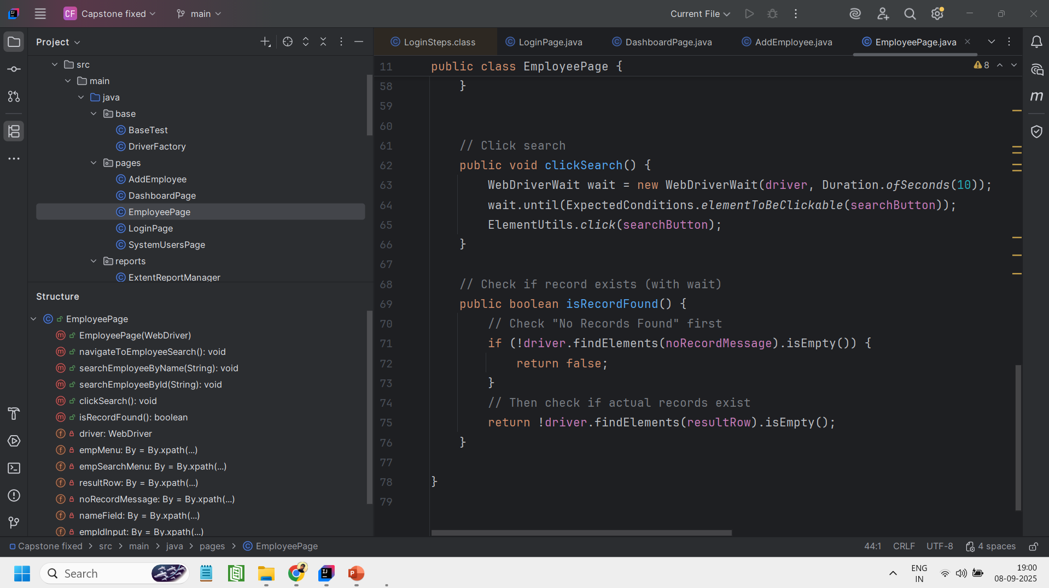
EmployeePage.java

Slide 20
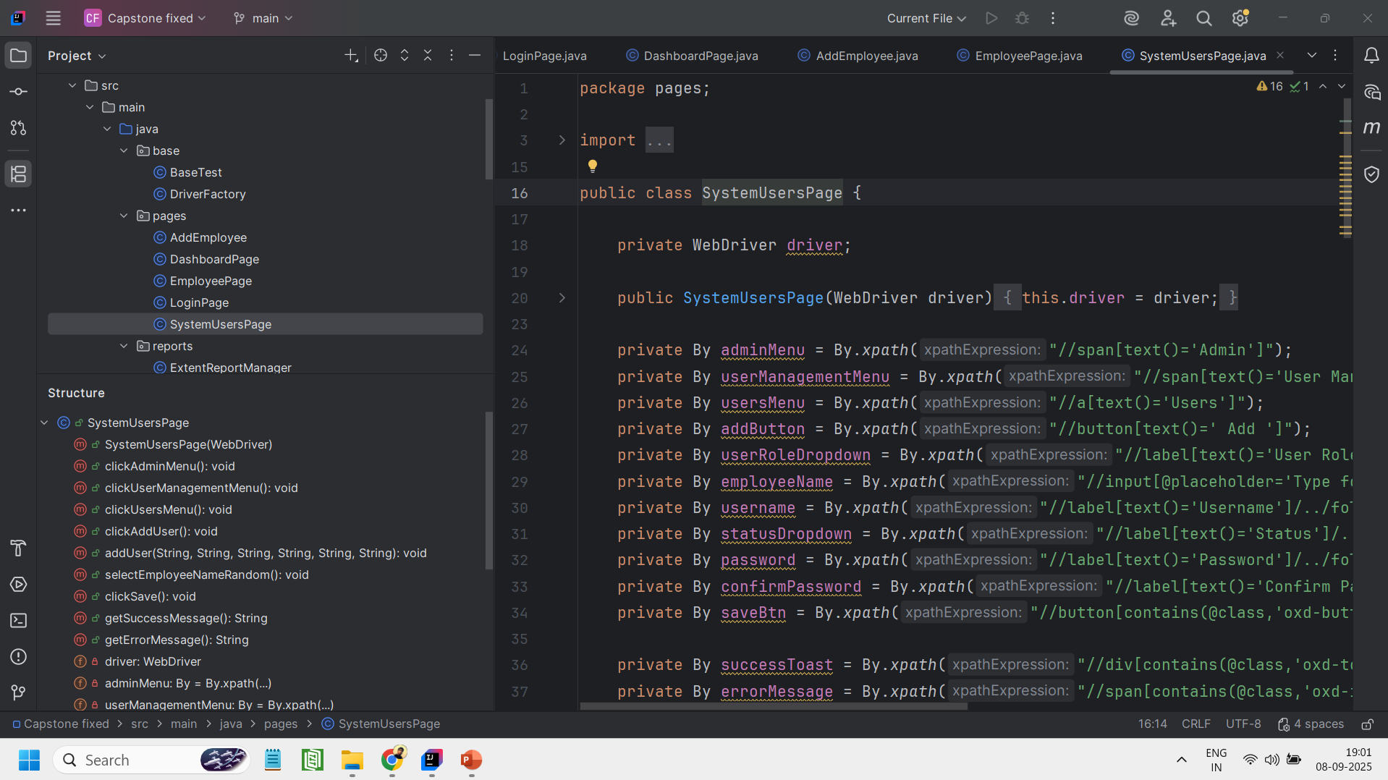
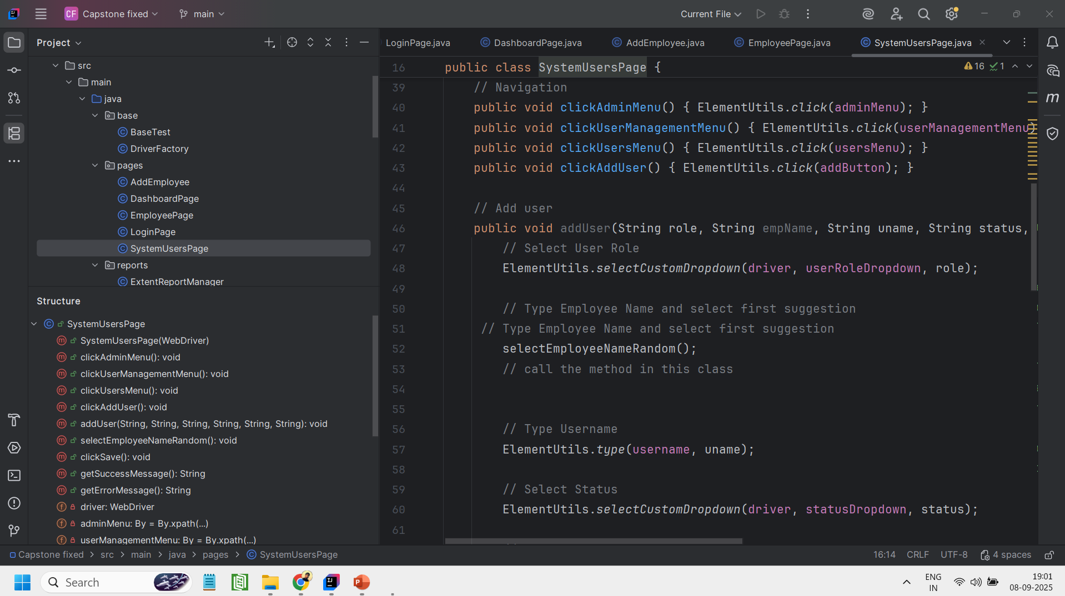
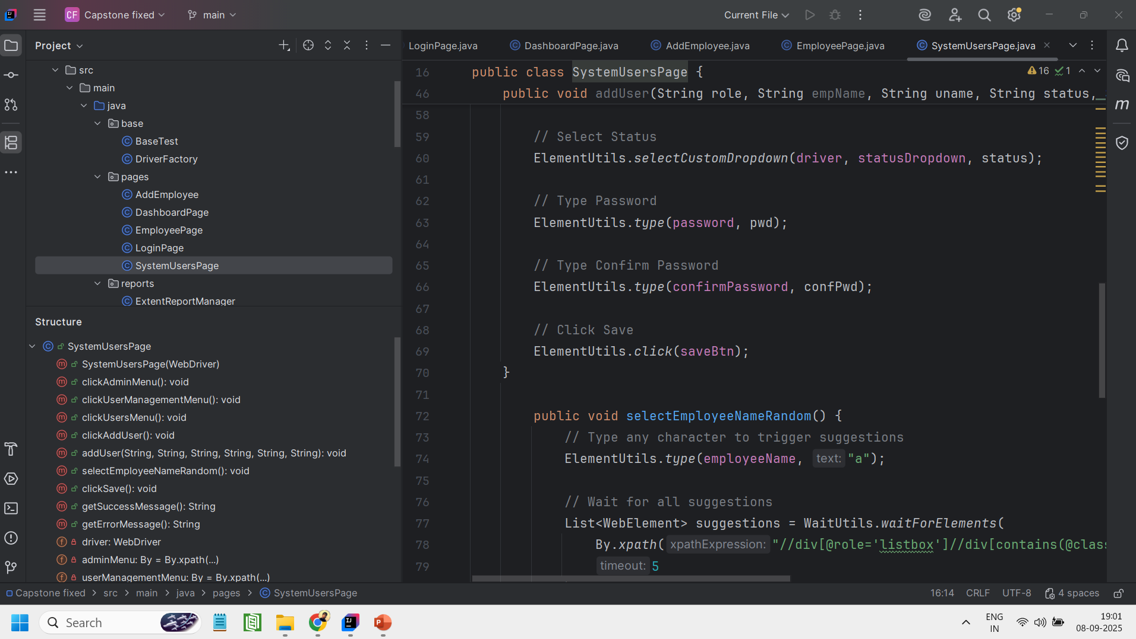
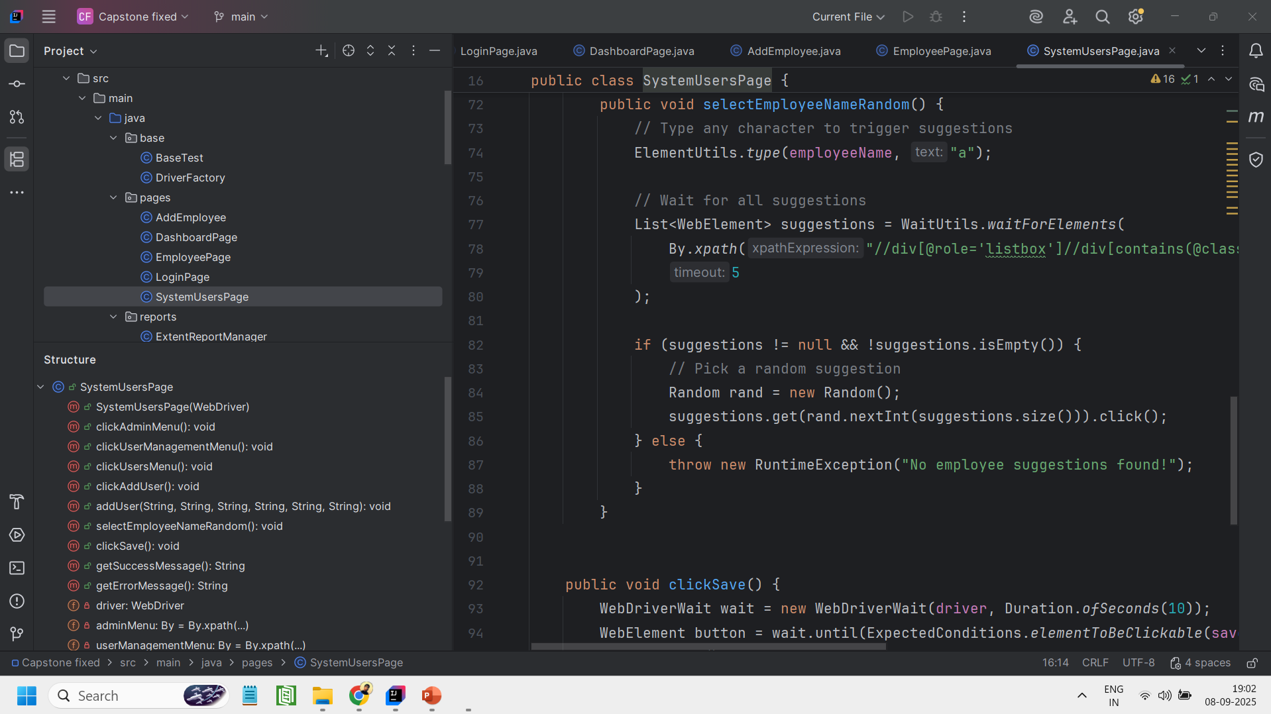
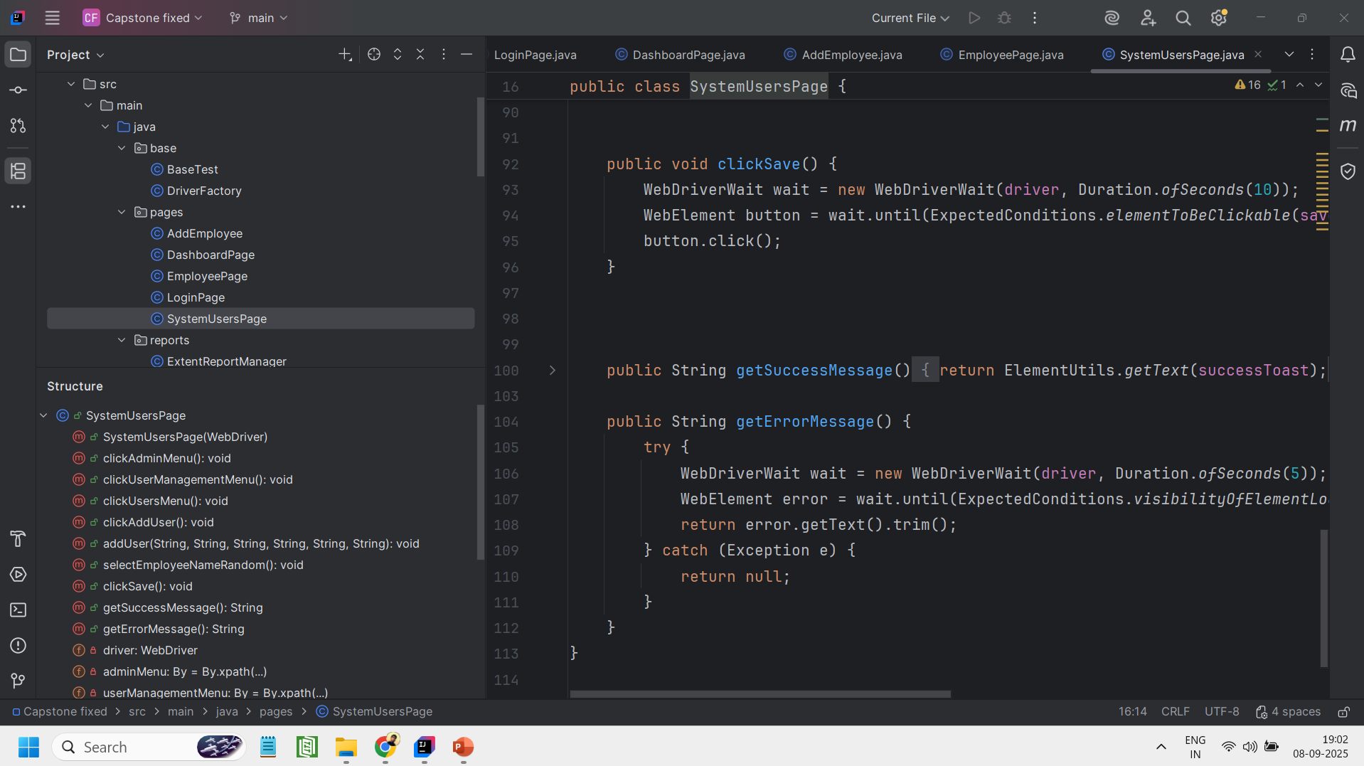
SystemUsersPage.java

Slide 21
Utility class
ElementUtils.java
Provides reusable helper methods like type, click, and dropdown selection to simplify Selenium actions.
Handles waits and visibility checks internally, ensuring tests run smoothly without flaky errors.
ExcelUtils.java
Provides a utility method to read data from Excel sheets, supporting data-driven testing.
Simplifies accessing cell values from a given sheet, row, and column.
Helps maintain separate test data files, making test scripts cleaner and reusable.
PropertyReader.java
Loads configuration and locator values from a .properties file, centralizing project settings.
Provides a simple method to retrieve property values using a key.
Helps make the automation framework flexible and maintainable without hardcoding URLs, credentials, or other configurations.

Slide 22
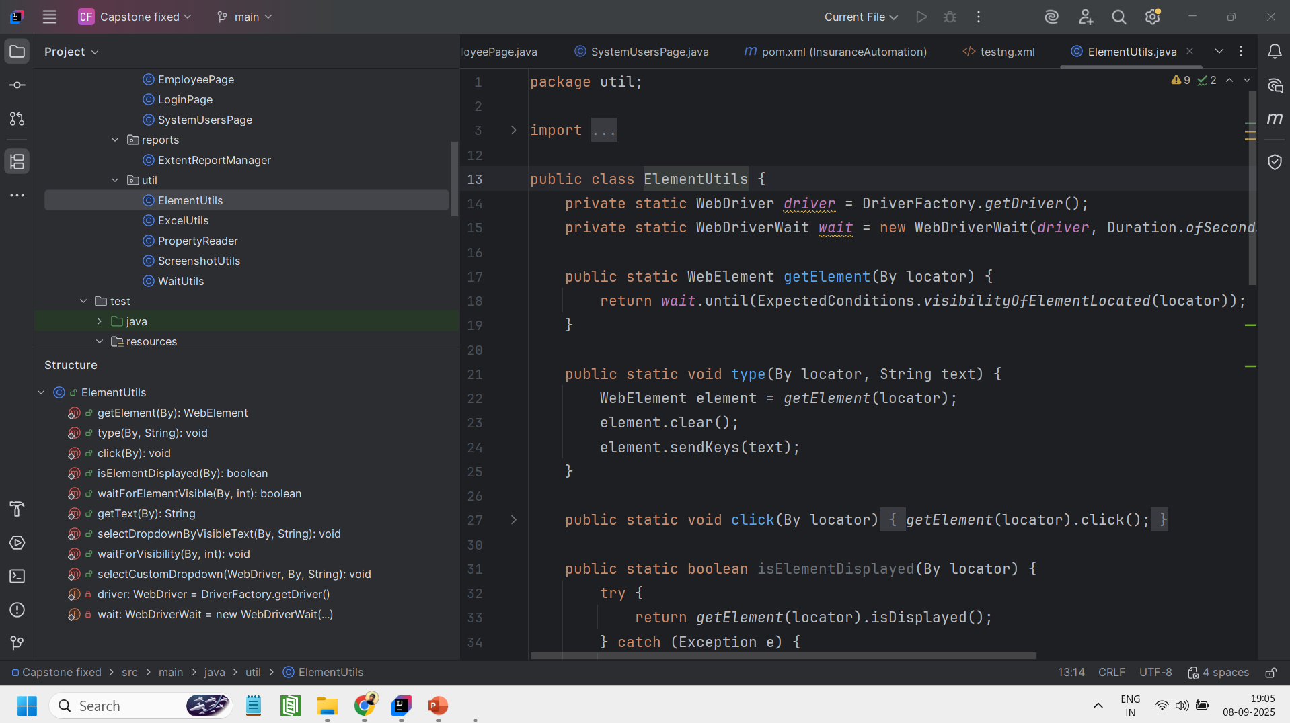
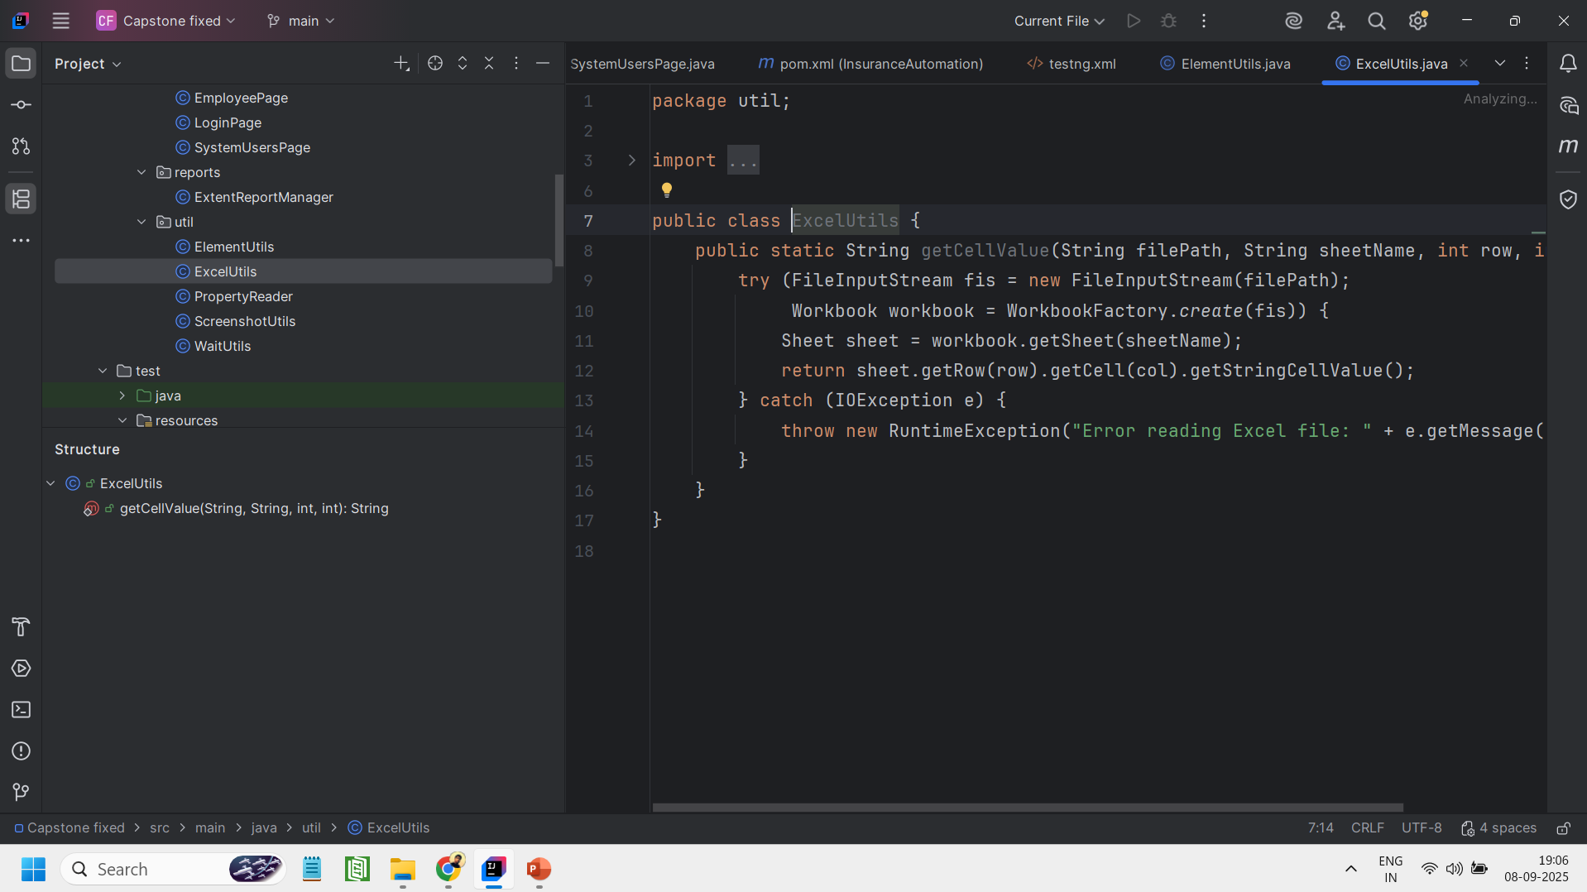
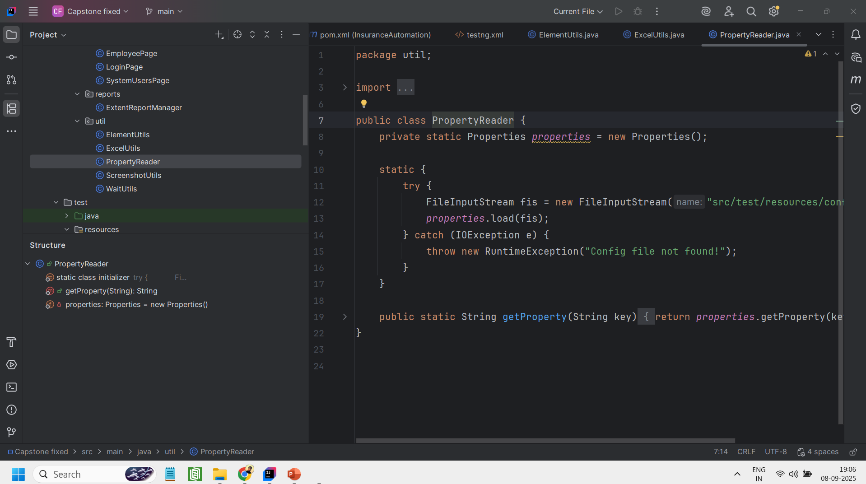
ElementUtils.java
ExcelUtils.java
PropertyReader.java

Slide 23
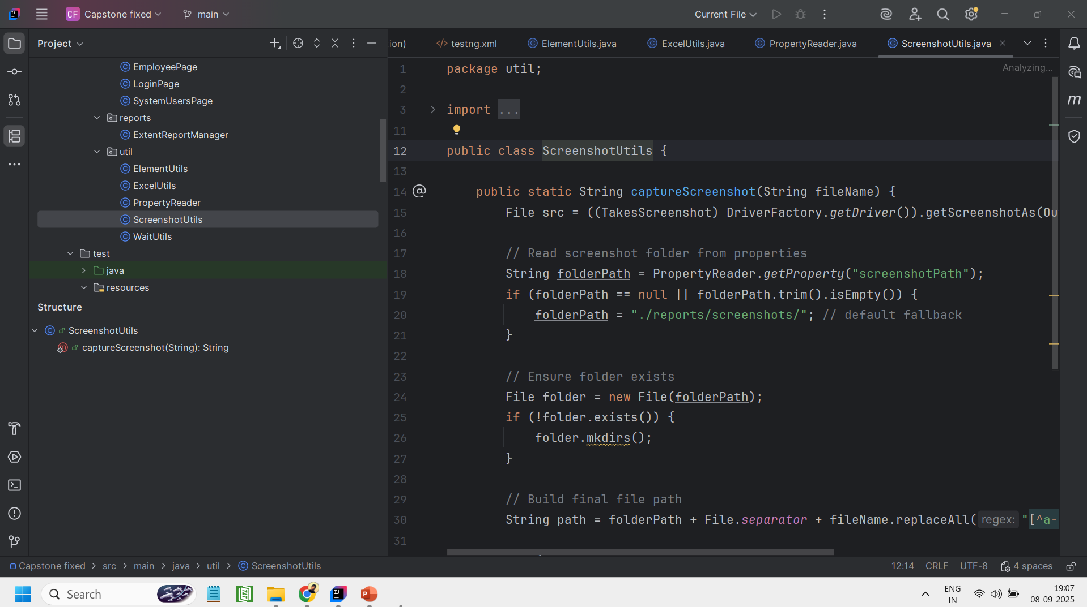
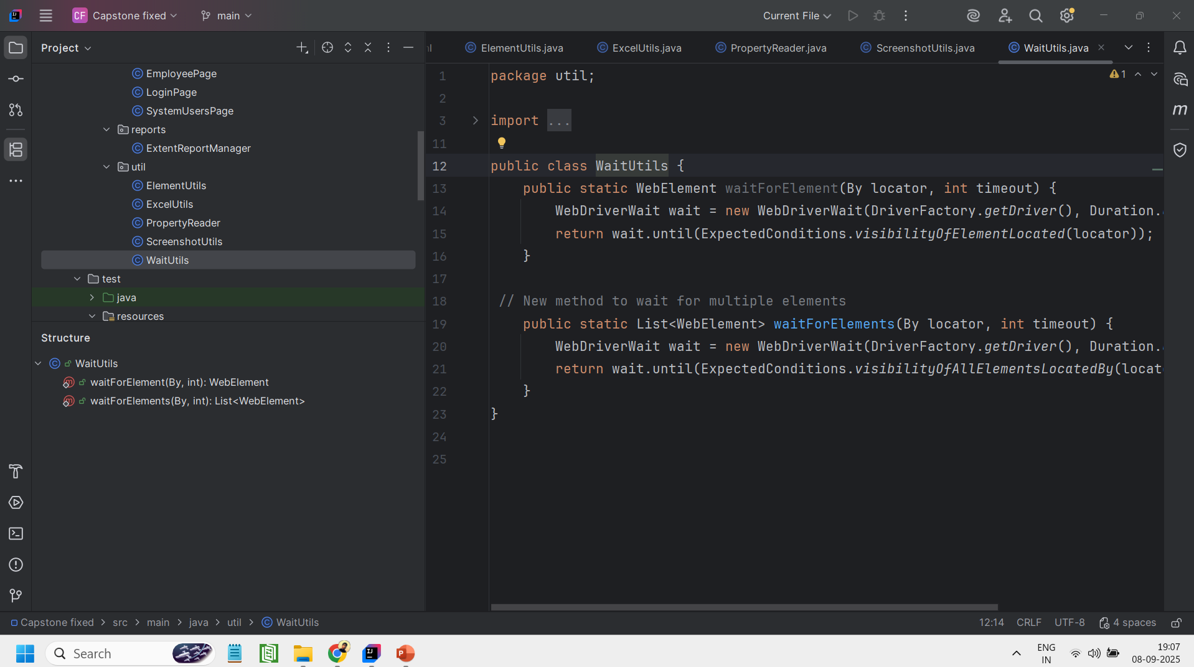
ScreenshotUtils.java
Captures screenshots of the current browser window during test execution.
Saves screenshots in a designated folder defined in the configuration file, with a default fallback path.
WaitUtils.java
Provides methods to wait for a single element to be visible before interacting with it.
Supports waiting for multiple elements to appear on the page simultaneously.

Slide 24
Base class
BaseTest.java
Provides a setup method to initialize the WebDriver and maximize the browser window before each test method.
Ensures proper cleanup by quitting the WebDriver after each test method.
Integrates with ExtentReportManager to flush test reports after execution.
DriverFactory.java
Maximizes the browser window and ensures a fresh WebDriver instance before each test.
Initializes and provides WebDriver instances for Chrome, Firefox, and Edge with language and browser-specific options.

Slide 25
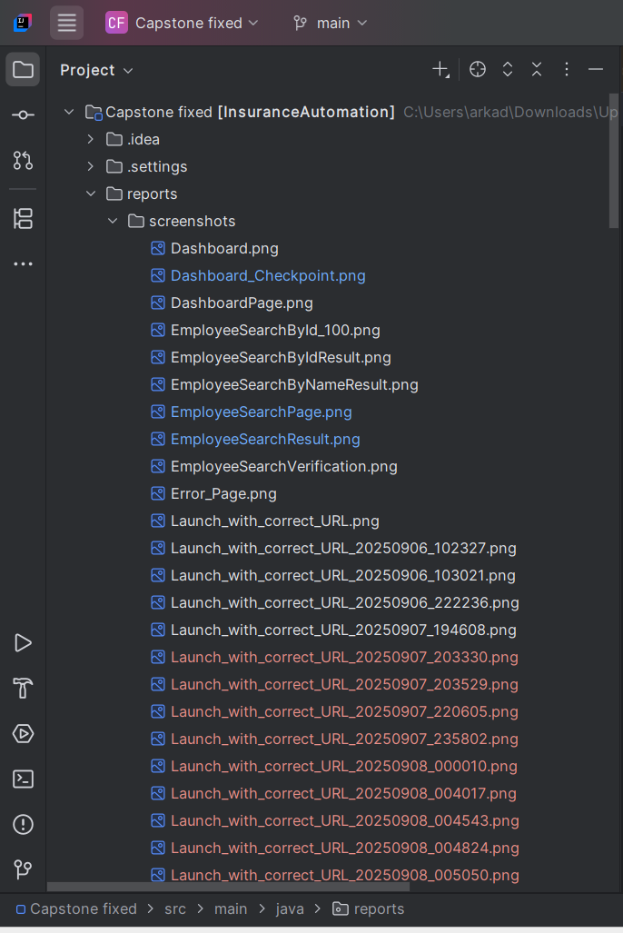
Report class
ExtentReportManager.java
Manages the creation and configuration of ExtentReports for test execution.
Creates timestamped HTML reports to ensure each test run has a unique report file.
Provides methods to create and retrieve individual test logs and flush reports to disk after execution.

Slide 26

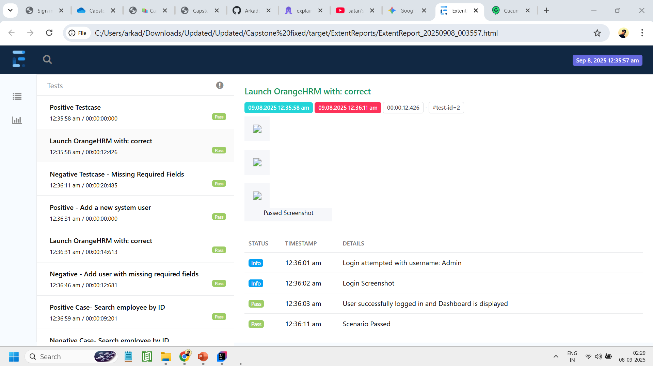
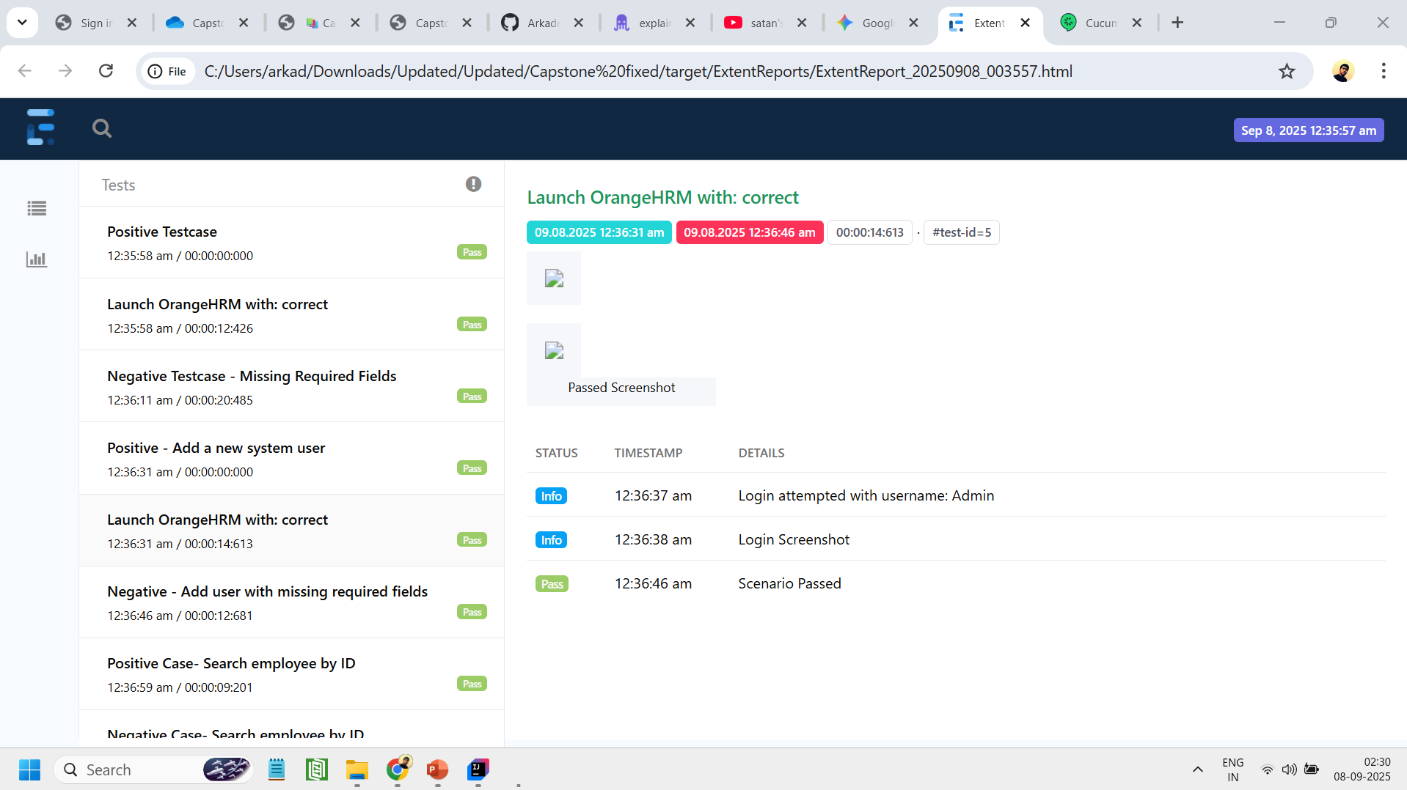
Extent Reports - I
ExtentReport.html

Slide 27
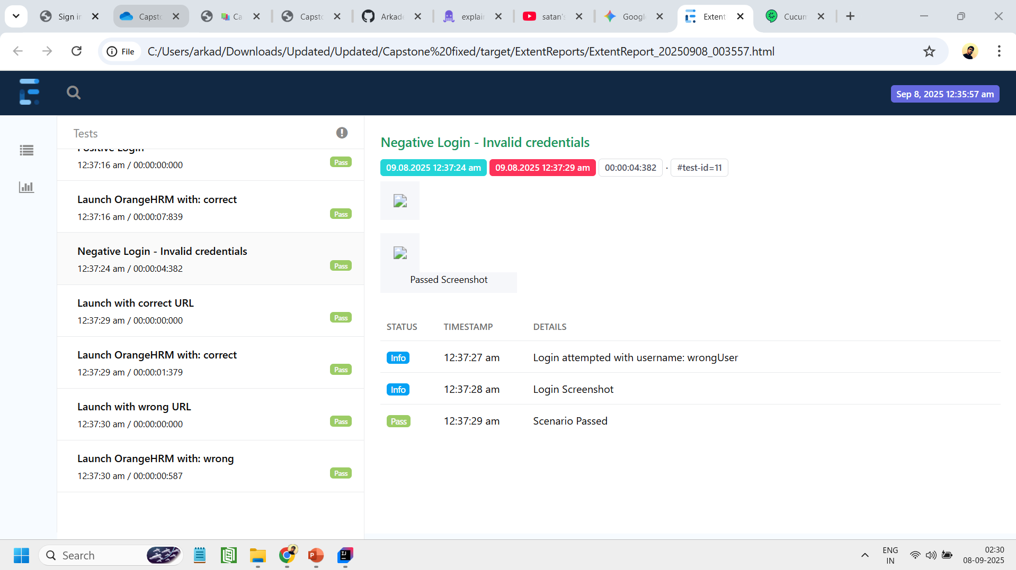
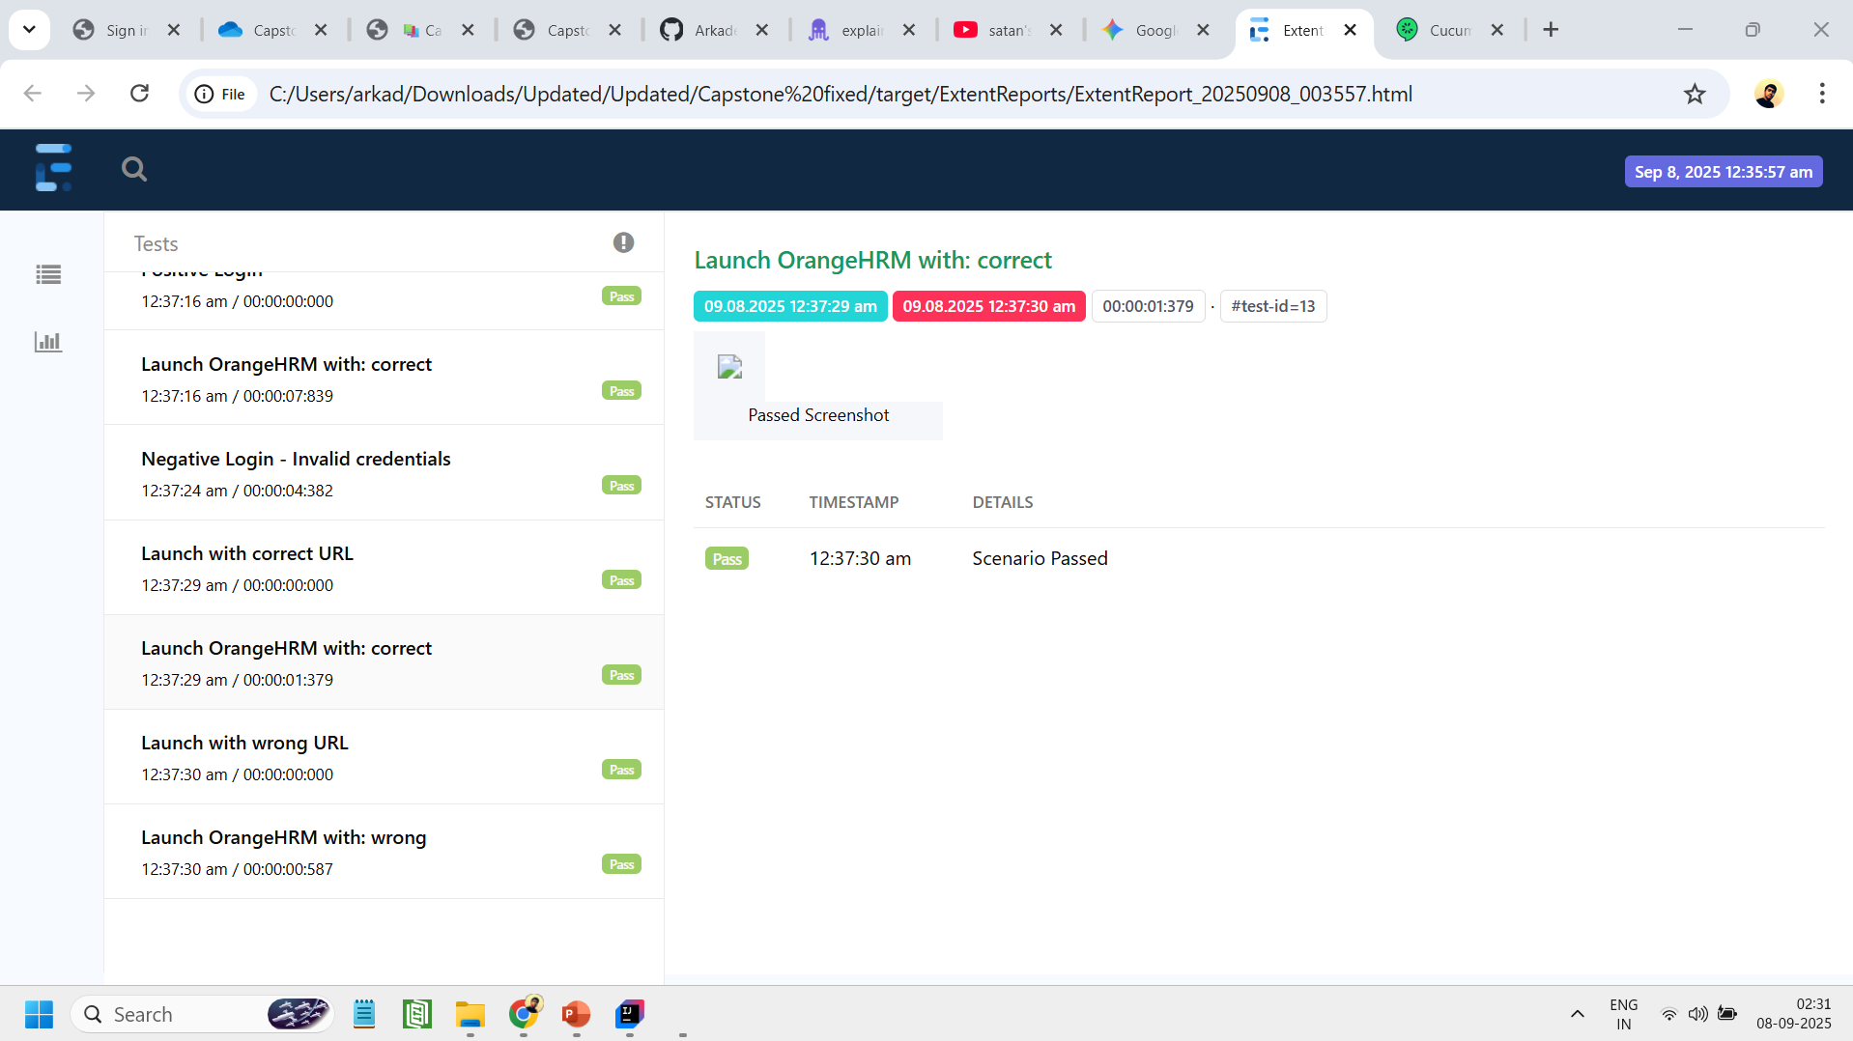
Extent Reports - II

Slide 28
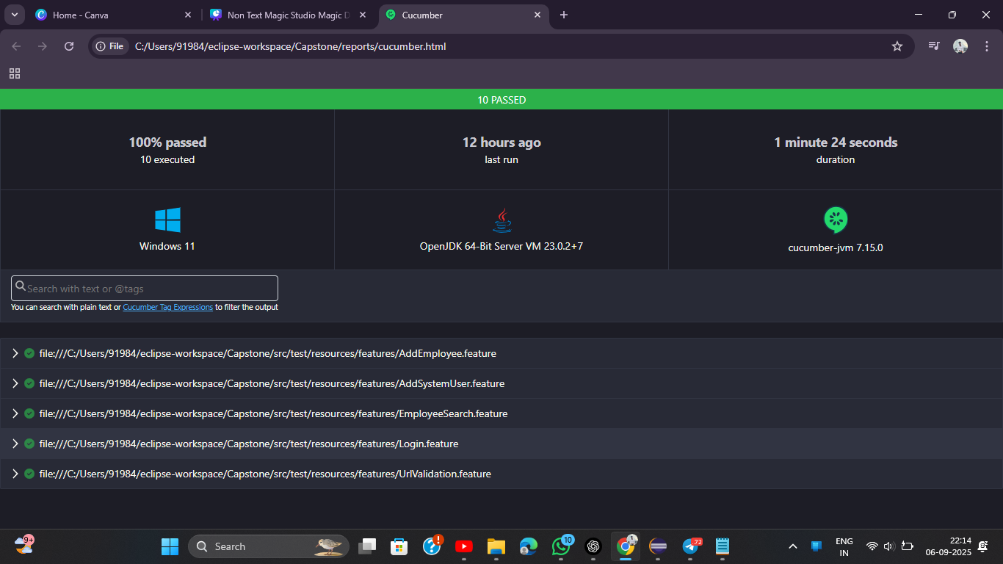
cucumber.html

Slide 29
Project Configuration & Build Management
Testng.xml
Defines the TestNG suite, specifying which classes or packages to run..
Ensures the Cucumber TestRunner is executed for all feature files.
pom.xml
Manages project dependencies, including Selenium, Cucumber, TestNG, Apache POI, and ExtentReports.
Configures Maven plugins for build, test execution, and report generation.

Slide 30
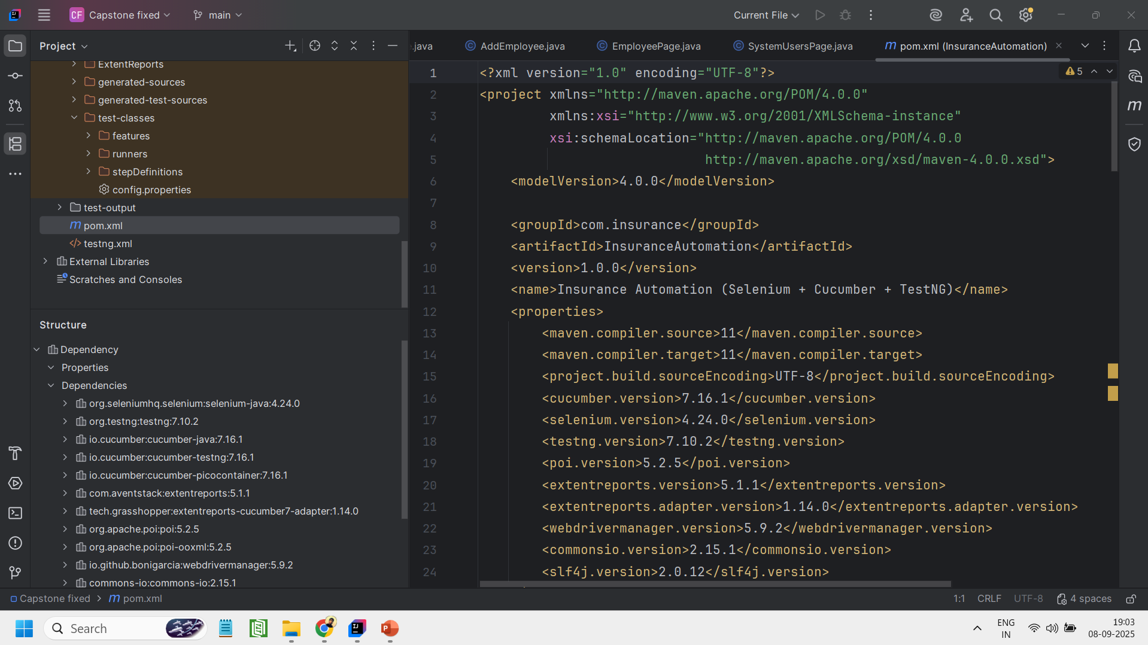
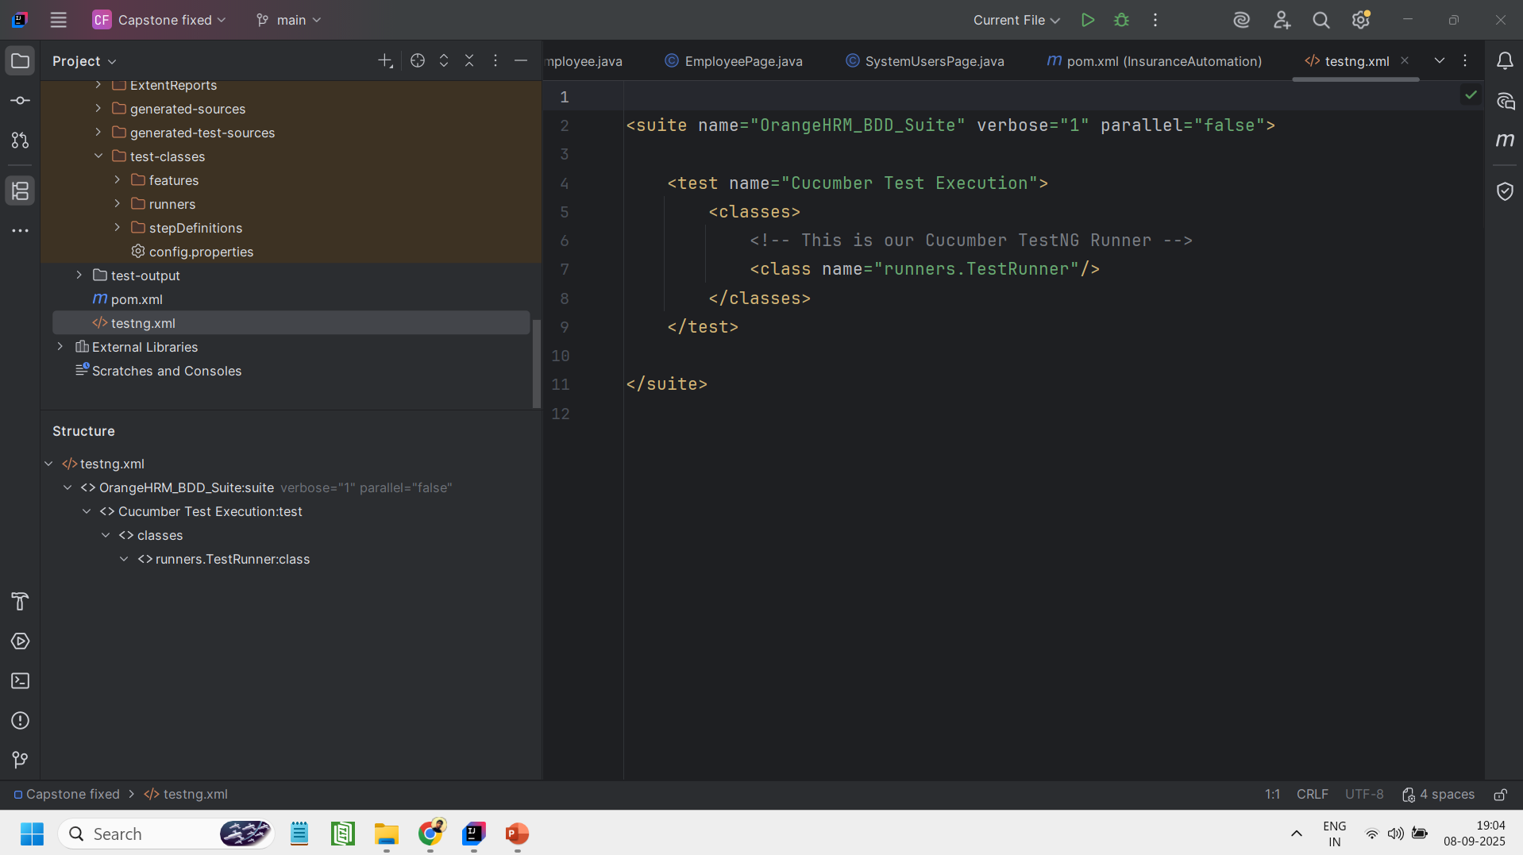
Testng.xml
pom.xml

Slide 31
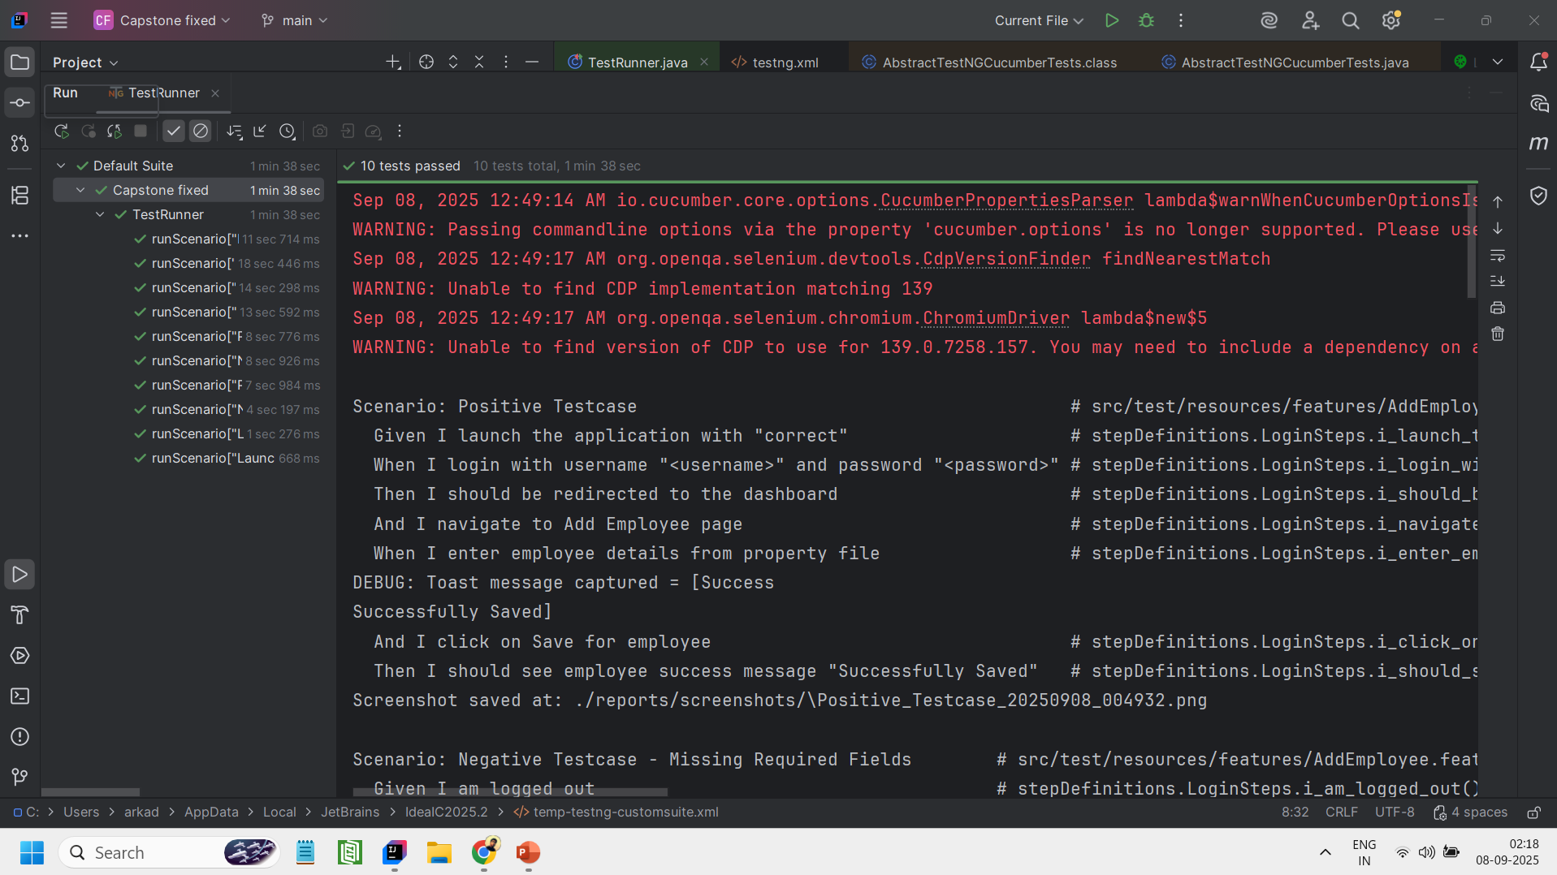
Console Output - I

Slide 32
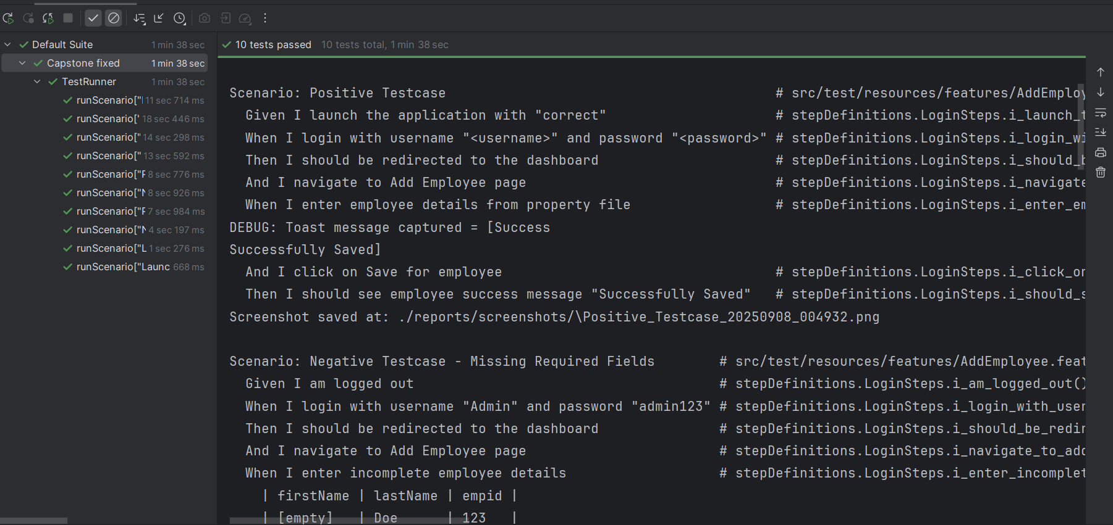
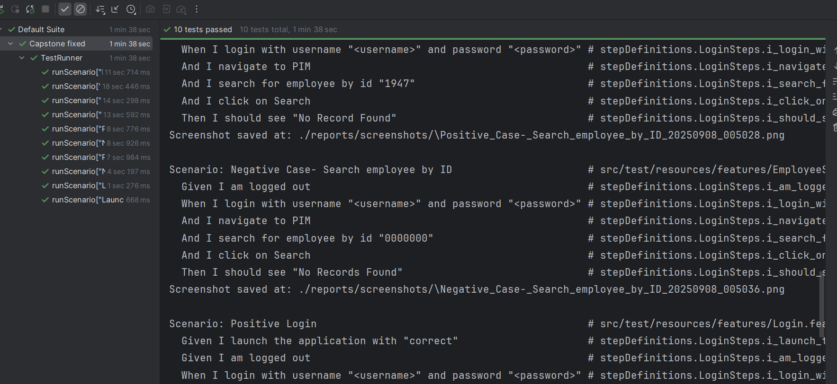
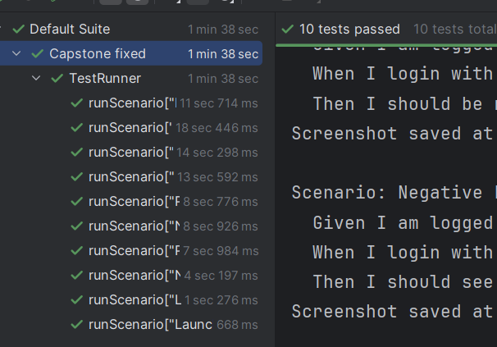
Console Output -II

Slide 33
GIT - Project Repository & Version Control
The complete project is hosted on GitHub for version control and collaboration.
Provides access to all feature files, POM classes, utilities, and test scripts.
Supports easy clone, pull, and push operations for updates since it is public.
Link to the repository: https://github.com/Arkadeep455/capstone-project

Slide 34
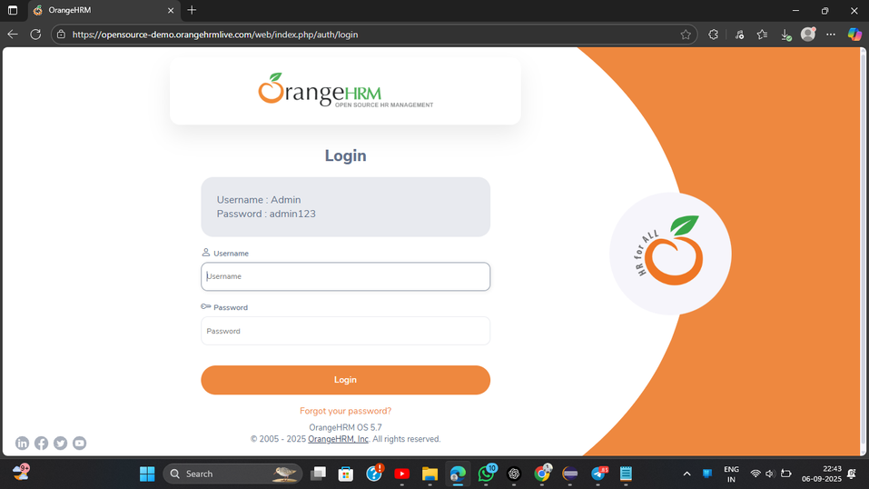
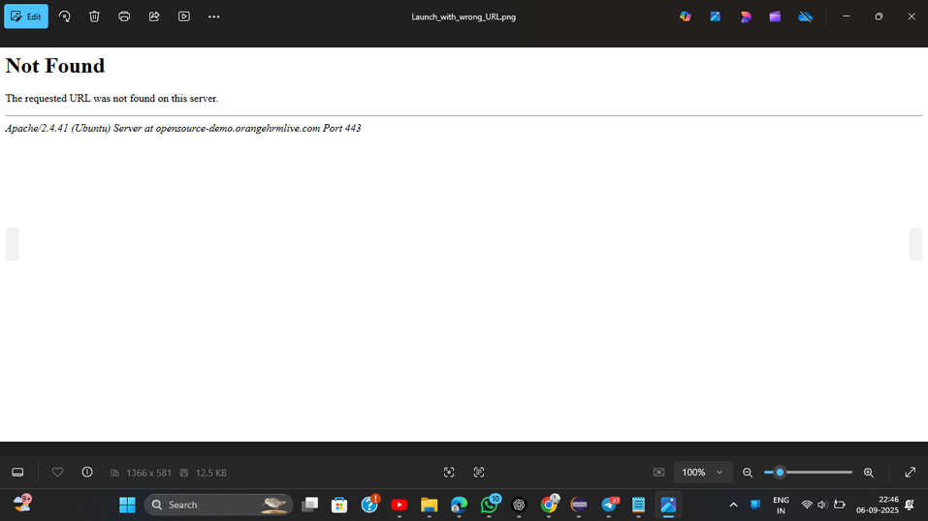
Screenshot - I
Testcase -1 : URL Validation
Positive Testcase
Negative Testcase

Slide 35
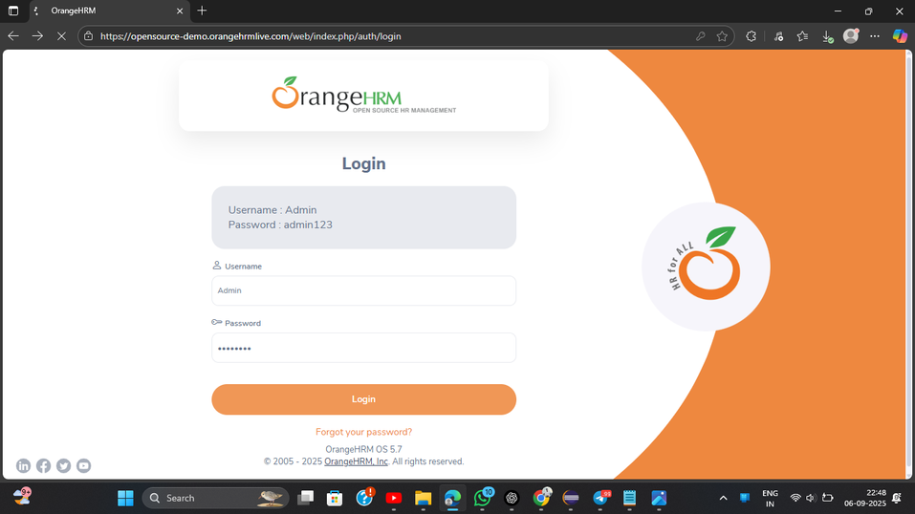
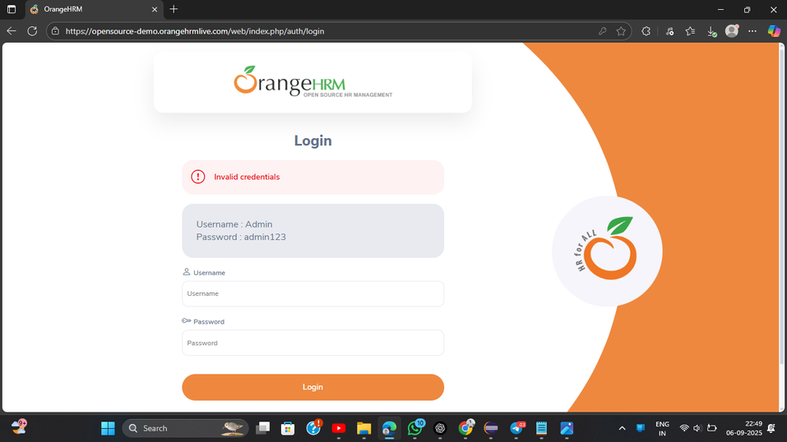
Screenshot - II
Testcase -2 : Login Functionality
]
Positive Testcase
Negative Testcase

Slide 36
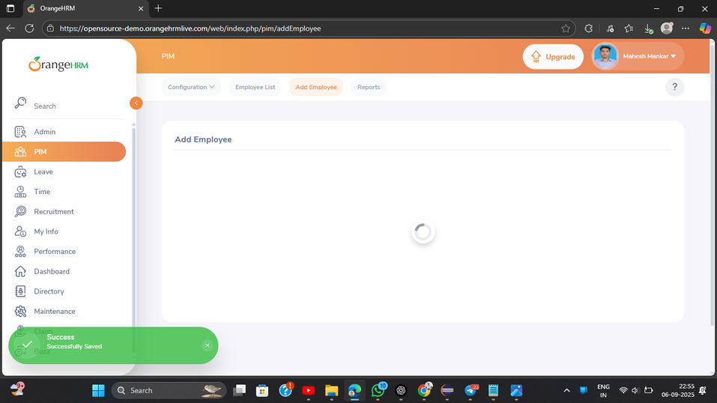
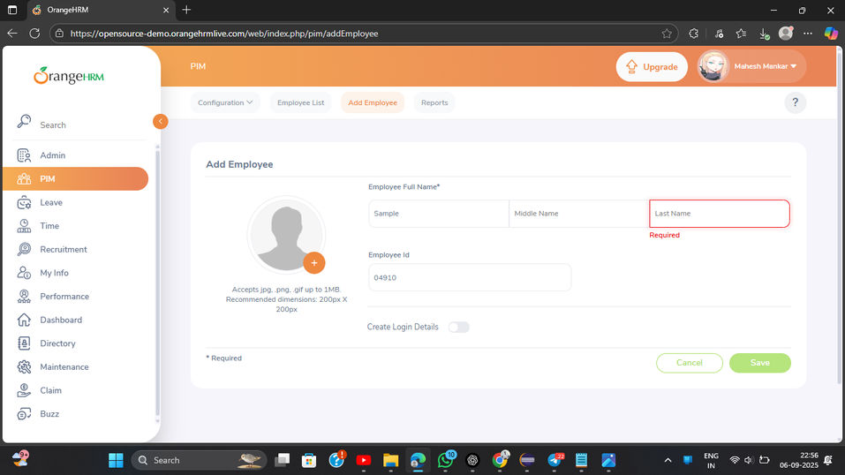
Screenshot - III
Testcase -3 : Add the Employee
Positive Testcase
Negative Testcase

Slide 37
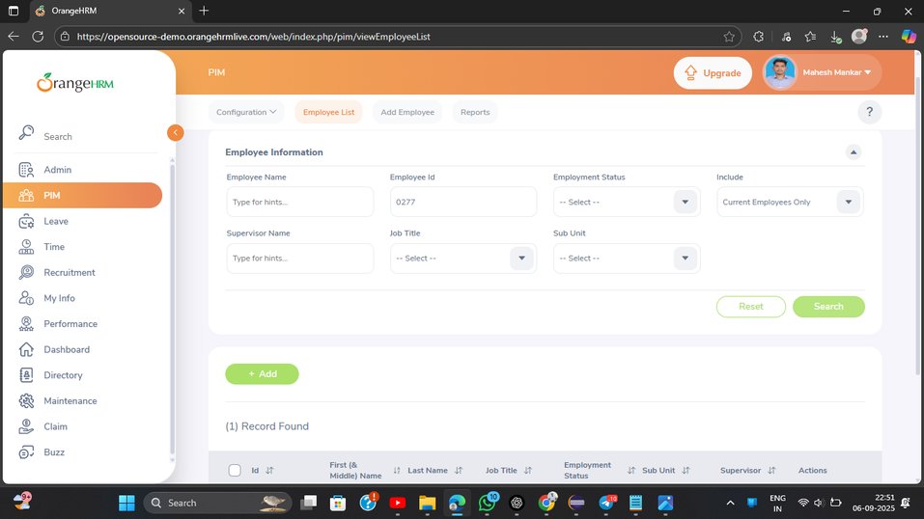
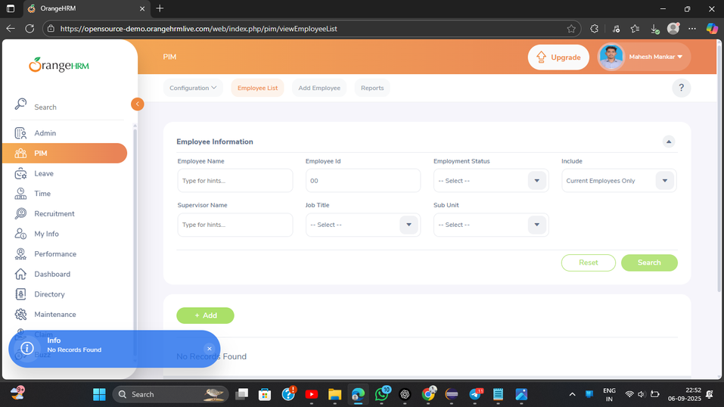
Screenshot - IV
Testcase -4 : Search the Employee
Positive Testcase
Negative Testcase

Slide 38
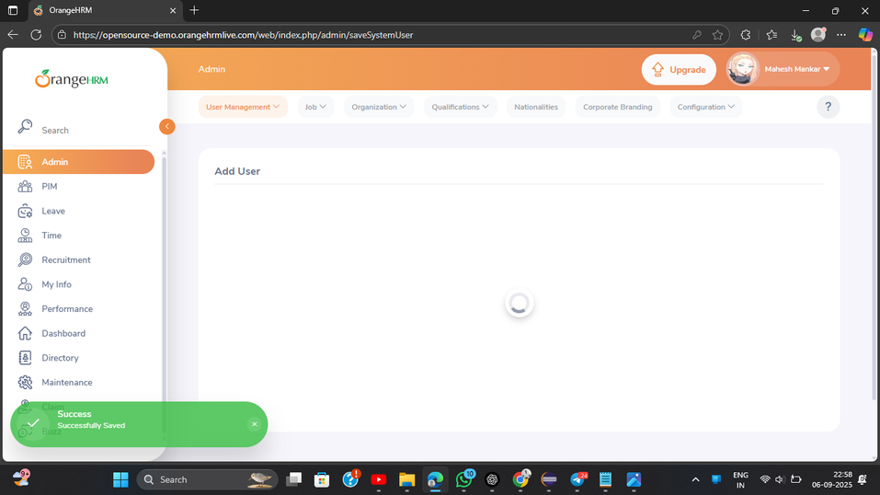

Screenshot - V
Testcase -5 : Add the User
Positive Testcase
Negative Testcase

Slide 39
THANK YOU

